Slide 1
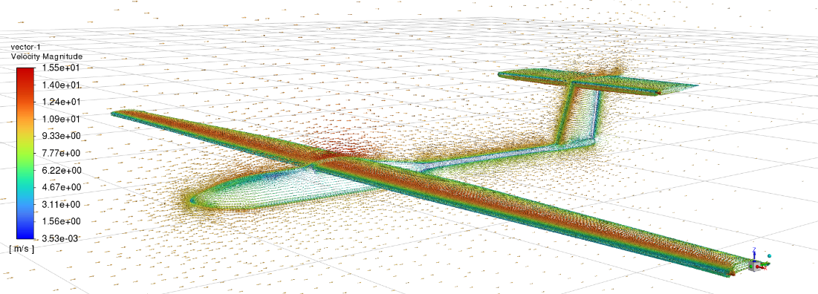
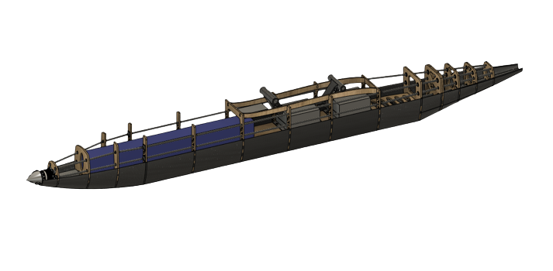
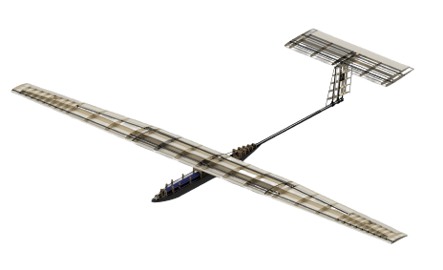
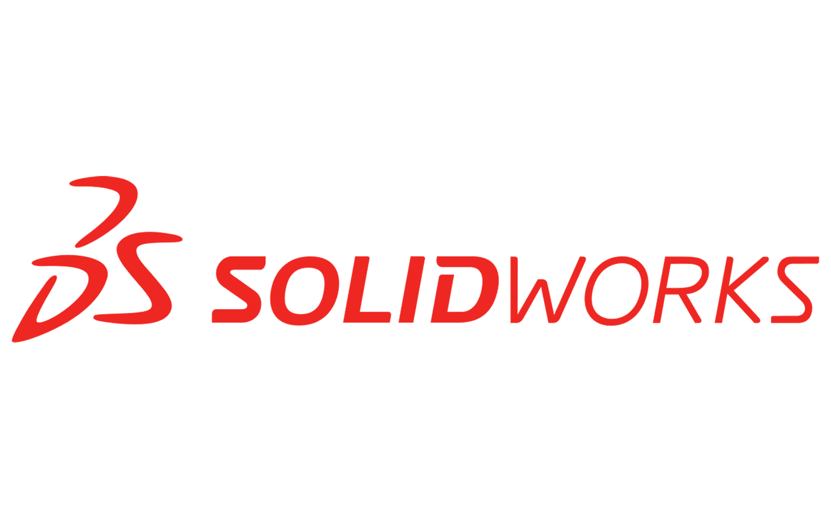
S.O.A.R.
Solar Optimized Aerial Research
Team Members: Melanie Rivera, Zachary Gross, Brady Buffington,
Anthony Vernachio, Ryan Holler, Daniel Aizenberg, Ryan Monte, Krista Sahadeo,
Patrick Quinn, Radu-Theodor Palaghianu, Rushon Riviere-Alexander
Dr. Douglas Willard, Dept. Of Aerospace Physics and Space Science, Florida Institute of Technology
Problem Statement
SOAR aims to break the world endurance record for a low-altitude unmanned aerial system under 50 kg set by Atlantik Solar by flying for over 81.5 hours. The goal is to design, fabricate, and test a solar-powered unmanned aerial system (UAS) that can convert and store energy for prolonged flight times. This lightweight UAS will set a new world record and can be used for reconnaissance, search and rescue, crop monitoring, and communications.
Project Objectives
The team shall design and build an unmanned solar aerial system.
The system shall perform a full charging and use rotation over a 36-hour flight test.
The team shall deliver a system capable of surpassing the current world record for low altitude, under 50 kg flight.
Aerodynamic Subsystem
Electrical Subsystem
Specifications:
Figure 2: 104 Solar Cell Layout
Solar Cell Output - 450 Watts
Total Battery Capacity - 130 Amp Hours
Max Thrust Produced - 26 Newtons
Telemetry Range – 500m
Position Determination Error - ± 2m
Response Time – 0.3 s
Figure 1: Dynamic Pressure Analysis
Structural Subsystem
Specifications:
Wingspan - 6m
Aspect Ratio - 12.67
Total Lift - 151.78 N
Total Drag - 8.21 N
Figure 4: Fuselage Model
Main Wing:
Modified Eppler 216 Airfoil produces optimal lift at zero angle of attack
Surface designed for solar cell placement
Design Methodology:
Fully deconstructable
Semi-monocoque fuselage structure
High strength carbon laminate belly plate
Facilitated access to electronics across UAS
Figure 3: Full UAS Model
Empennage:
NACA 0008 Airfoil used for horizontal stabilizer at –0.6 degrees angle of attack
NACA 0012 Airfoil used for vertical stabilizer
Specifications:
Mass– 14 kg
Carbon fiber spars
Fiberglass and Monokote skin
Balsa wood ribs, shear webs, and stringers
Acknowledgements

