Slide 1
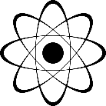
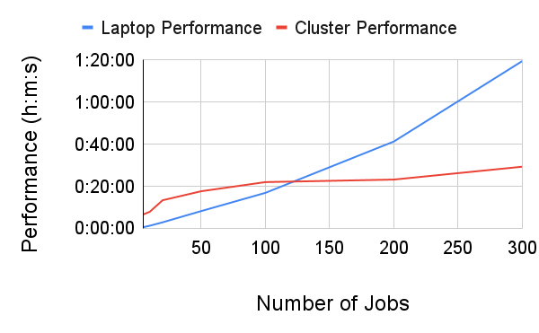
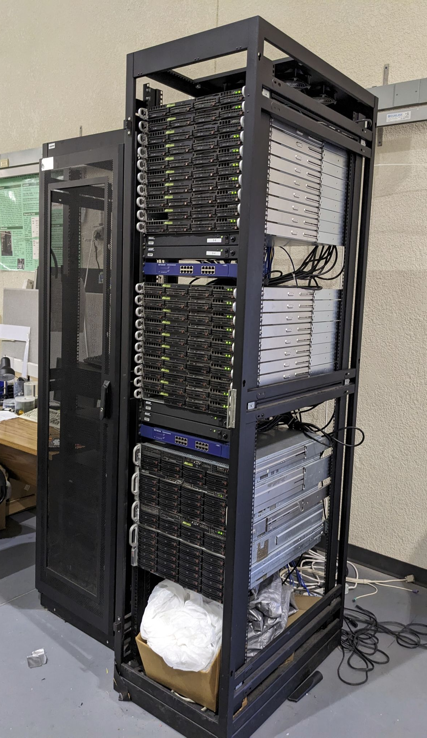
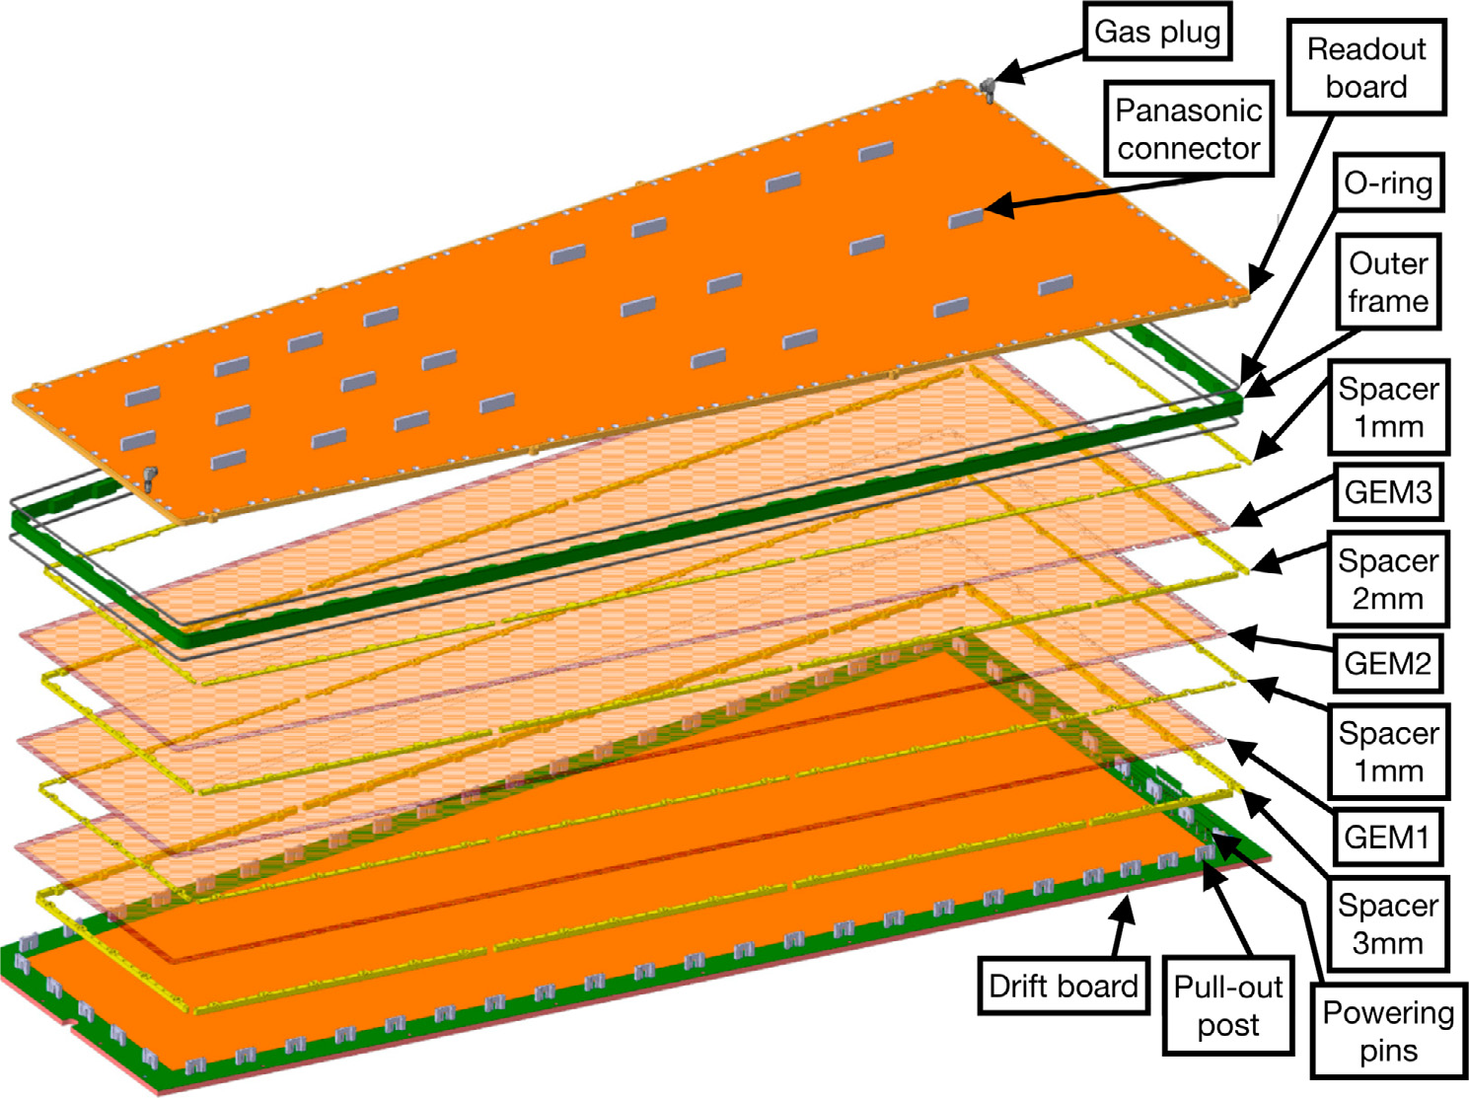
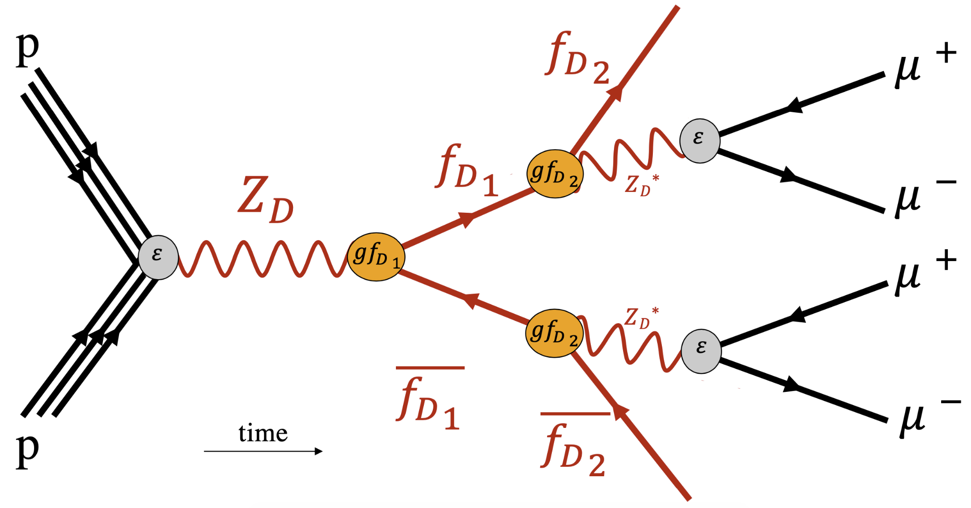
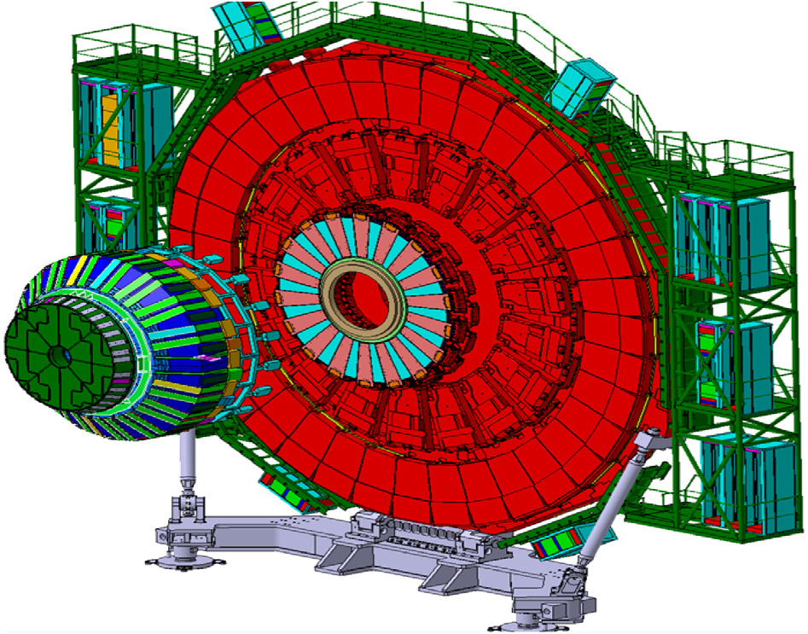
Physics Simulations on a High Throughput Computing Cluster
Andrew Capalbo
Faculty Advisor: Dr. Marcus Hohlmann, Dept. of APSS, Florida Institute of Technology
Faculty Observer: Dr. Hamid Rassoul, Dept. of APSS, Florida Institute of Technology
Background
The HEP Computing Cluster is owned by Dr. Hohlmann’s physics group and is used by its members to conduct simulations. The rebuild process was started in Spring of 2022 and was completed this past Fall. The cluster is comprised of 20 worker nodes, 16 of which are currently active, a frontend compute element (CE) and 2 Network Attached Storage (NAS) devices.
Methods and Software
This project required many software packages to run the simulations. These include:
Geant4, used for simulating particle collisions and interactions.
CMSSW, is a software packaged maintained by the CMS project at CERN, and is used for simulating the P-P collision producing a dark photon.
MadGraph, a Monte Carlo event generator that is used to define the process of the P-P collision as input to CMSSW.
Pythia, another Monte Carlo simulator, is used in conjunction with CMSSW to recreate accurate particle collisions.
HTCondor is the batch-job scheduling software that is used to distribute jobs over the available pool of nodes.
The GEM detector is simulated by firing a beam of electrons at the detector and tracking their positions. This output can the be analyzed.
Fig 4: Feynman Diagram of P-P collision, Stephen Butalla, 2023
The CMSSW simulation has 4 stages. Stage 1: Production of Universal Feynman Output (UFO) files using Mathematica. These files were provided by Stephen Butalla. Stage 2: Use UFO as input to MadGraph, where the dark photon and fermion and the collision are generated in the form of Les Houches Events (LHE) files. Stage 3:Using these LHE files as input to CMSSW, where the collision is simulated in conjunction with Pythia and Geant4. Stage 4: Analyzing output using a CutFlow Analyzer code which cuts the data based on kinematic analysis. This portion of the project has been halted at step 3. A required package for CMSSW, MuJetAnalysis, is missing, and attempts to install have resulted in errors.
Methods Cont.
A script was written that runs the simulation in batches of up to 300 jobs. A similar script was written to perform this same process using HTCondor.
Results and Conclusions
Fig. 1: HEP Compute Cluster
Fig. 2: Expanded view of GEM detector , D. Abbaneo, M. Abbas, M. Abbrescia et al, 2019
Fig. 5: Computation Metrics for GEM Detector
The first round of testing using the Geant4 detector shows an exponential growth in computation time for an average laptop, while the cluster has a small increase and then levels off to about 30 minutes. These results showcase the parallel computing capabilities of the cluster. The laptop must perform each simulation sequentially, thus resulting in the exponential growth. The cluster, however, is able to distribute the batch of jobs over a pool of over 100 CPU’s. There is a slight increase in growth in computation time as the HTCondor system is controlled by the CE using a scheduling daemon. When a large number of jobs are submitted, this daemon can get behind in scheduling jobs. When paired with the increase in network traffic, there is bound to be a small increase over time using the cluster. However, its computing capabilities far outperform the laptop on large batch jobs.
The first simulation to be tested was a Gas Electron Multiplier (GEM) detector. This detector is used in the CMS experiment at the Large Hadron Collider. It is comprised of 3 GEM foils, which are 50 𝞵m of kapton sandwiched between 5 𝞵m of copper. The second simulation is a recreation of a proton-proton collision which produces a dark photon in the CMS detector using CMS Software Components (CMSSW)
Acknowledgements
Fig. 3: Render of CMS Endcap , D. Abbaneo, M. Abbas, M. Abbrescia et al, 2019
Thank you to Merrick Lavinsky, Stephen Butalla, Zackery Wihela, Jose Fuentes, and Dr. Marcus Hohlmann for their assistance with this project.

