Slide 1
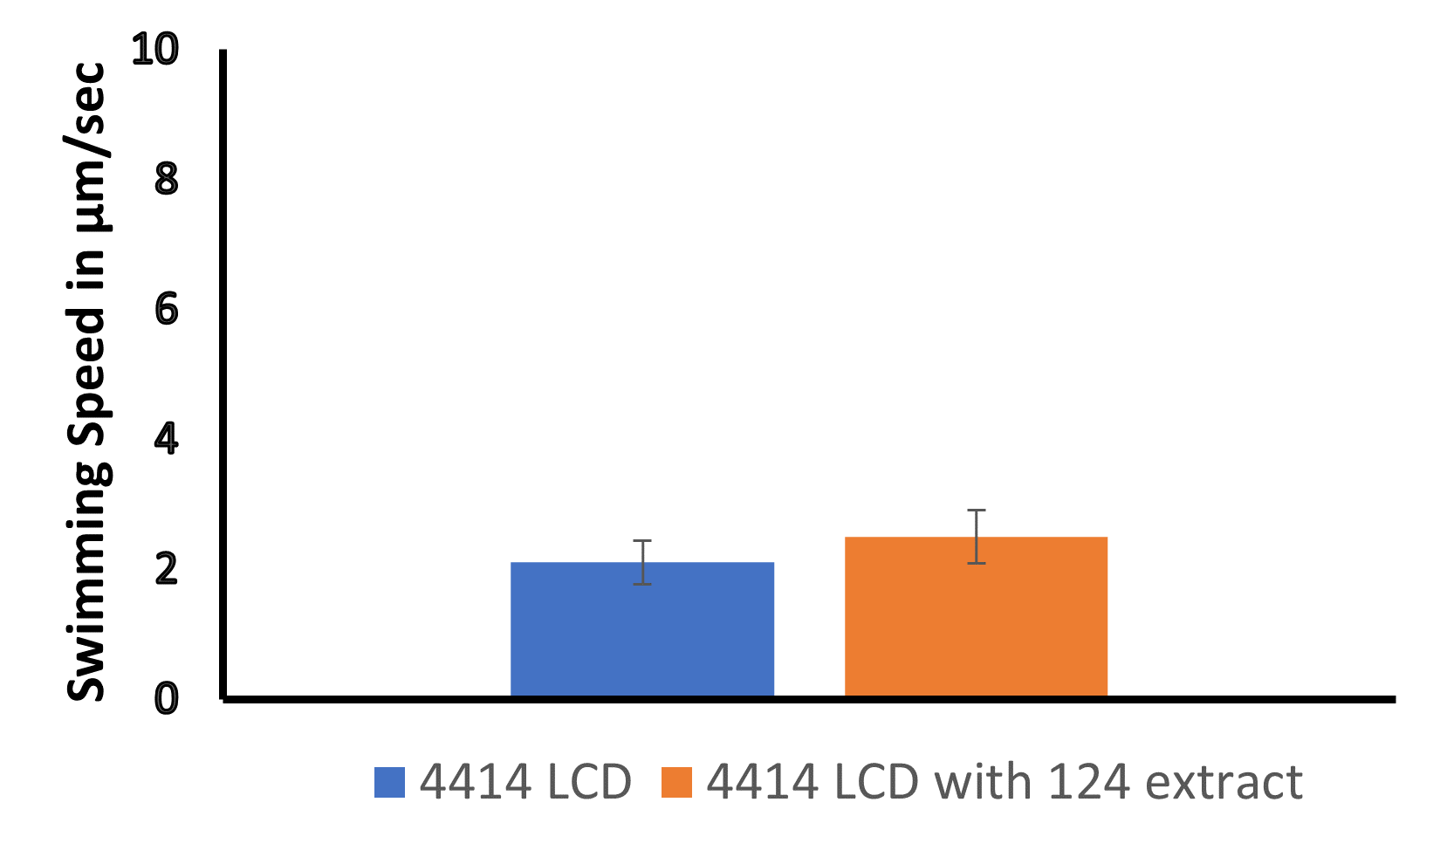
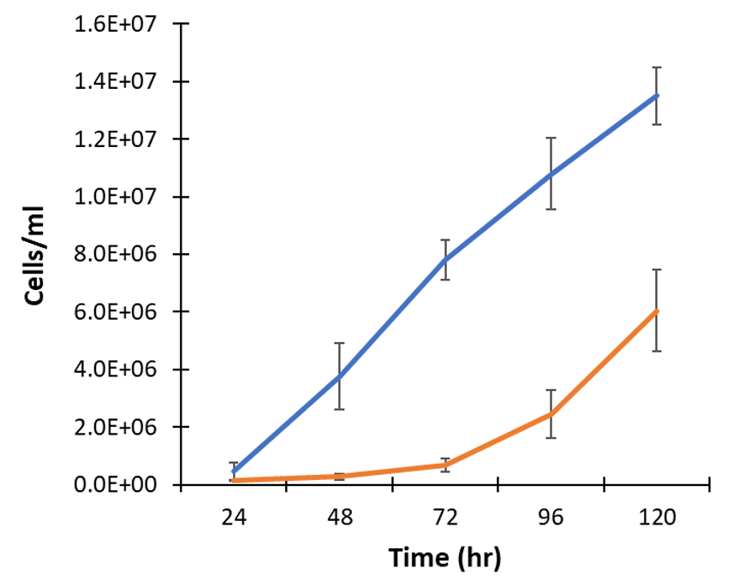
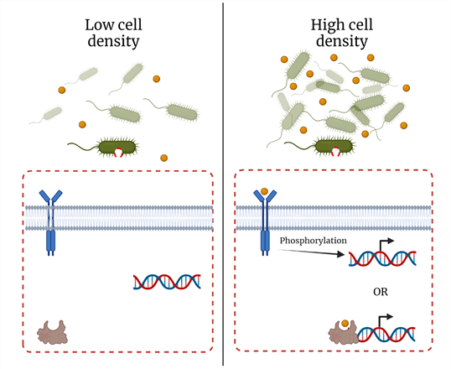
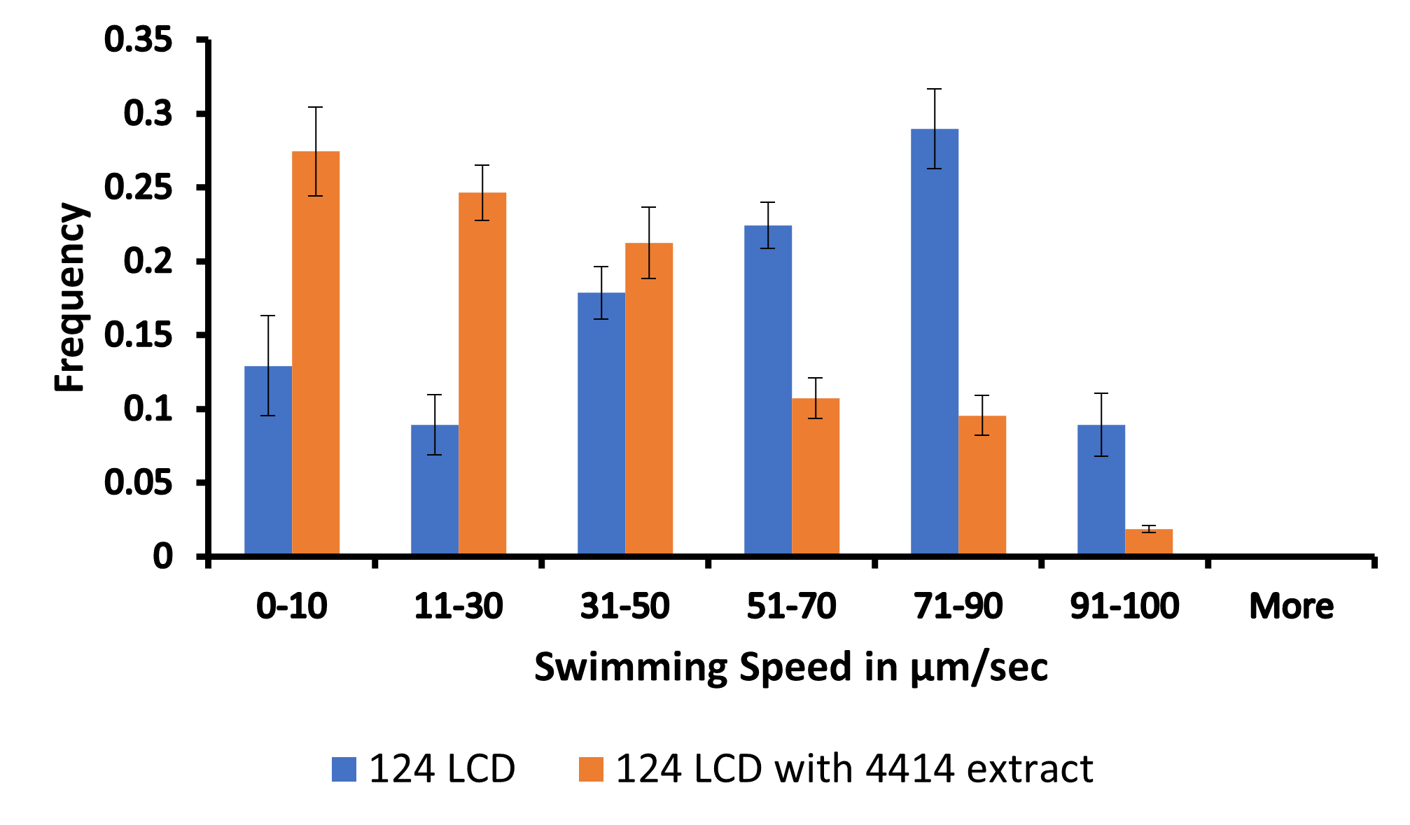
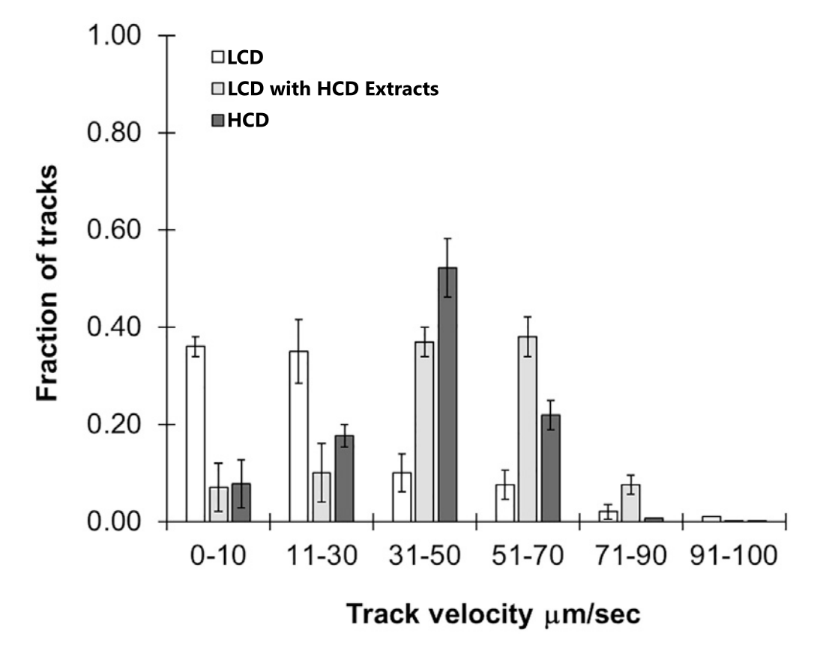
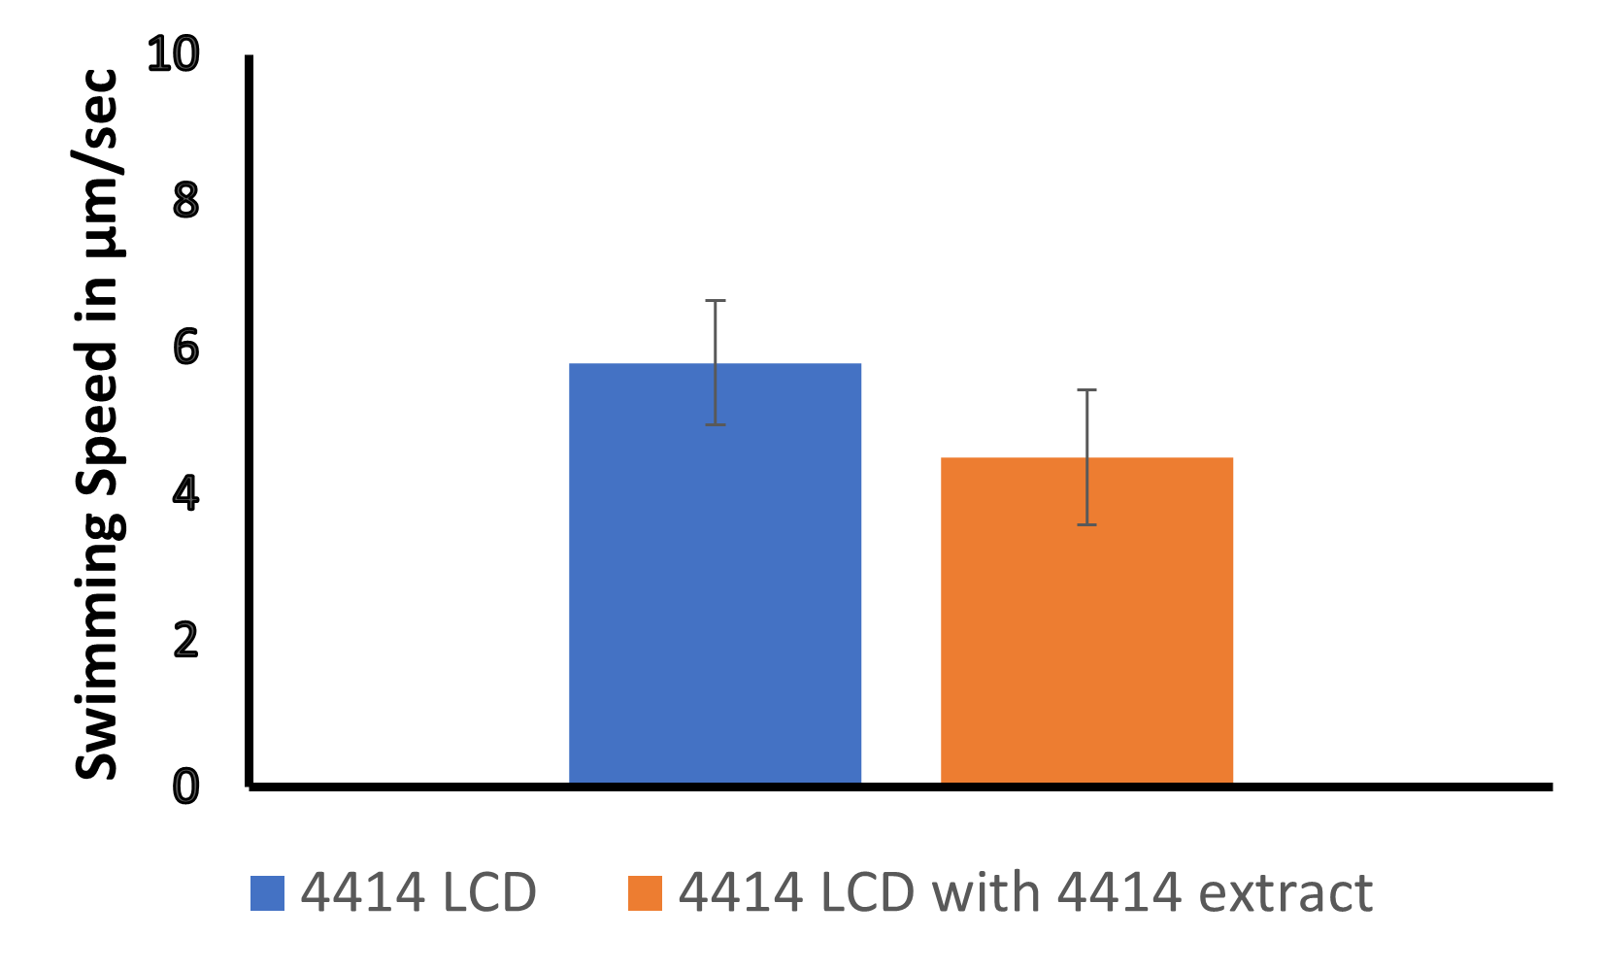
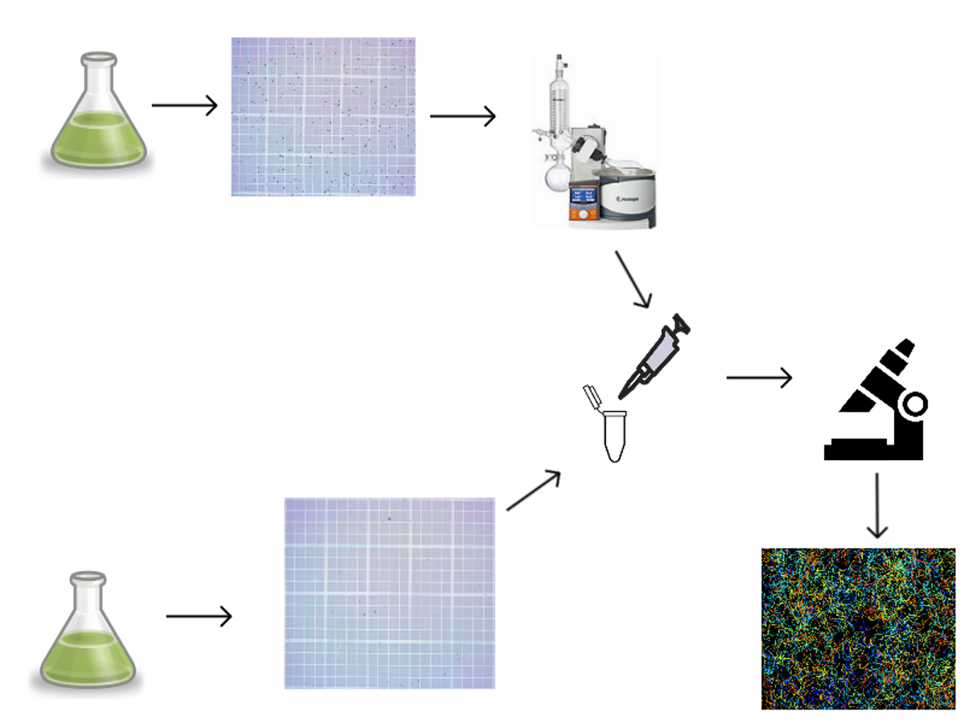
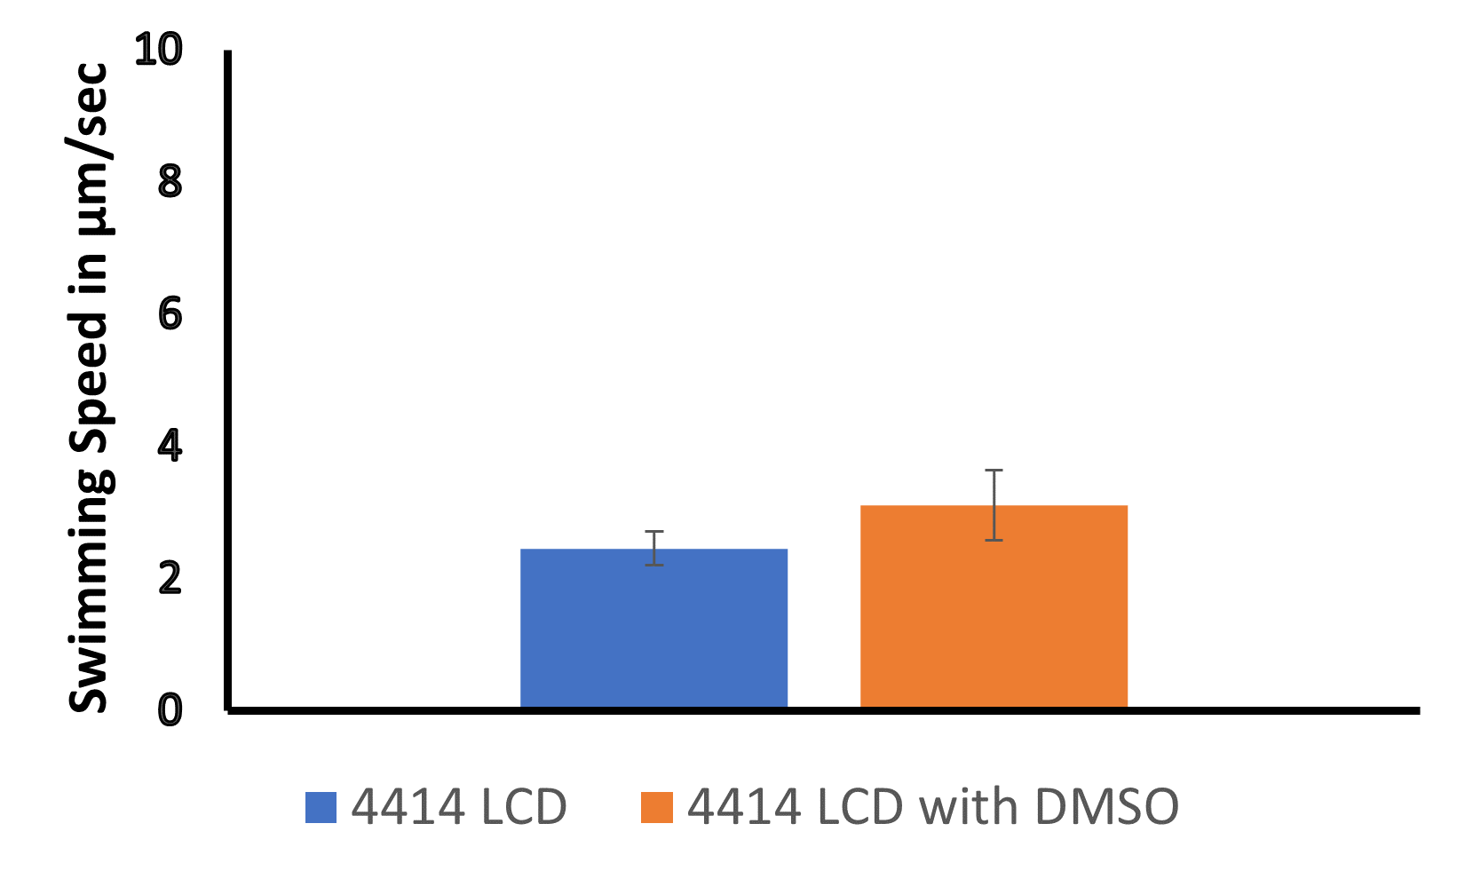
Characterization of CC4414 a potentially non-quorum sensing variant of Chlamydomonas reinhardtii
Elijah Soyke
Faculty Advisor: Dr. Andrew Palmer, Dept. of Biomedical and Chemical Engineering and Sciences, Florida Institute of Technology
Background
Results
Quorum Sensing (QS) allows microorganisms to couple phenotypic switching to cell density (Figure 1)
Figure 1: QS signals (gold spheres) are synthesized at a constitutive level and exuded into the environment. As cell density increases, the signal concentration also increases. Signals directly or indirectly initiate transcription of the genes associated with high-density phenotypes.
Figure 7: LCD CC4414 cultures were treated with extracts of HCD CC124 cultures. Samples were incubated for 1 hour then observed for changes in swimming speeds. (N=12) Error bars indicate standard error.
Chlamydomonas reinhardtii (wildtype CC124), a photosynthetic eukaryote, uses QS to regulate swimming speed (Figure 2) in response to an unknown molecule, the Chlamydomonas swimming speed factor (CSSF)
Figure 4: Cultures of CC124 (blue) and CC4414 (orange) were grown in Tris-acetate phosphate (TAP) buffer (pH: 7.0). Cultures were grown at 23°C under 24 hr lighting at 150 rpm. (N=12) Error bars indicate standard error.
Figure 2. Swimming speeds of low cell density (LCD) cultures at 5x10⁵ cells/ml, high cell density (HCD) cultures at 5x10⁶ cells/ml, and LCD cultures incubated with extracts containing the CSSF.
Figure 5: LCD (7x10⁴ cells/ml) CC4414 cultures were treated with extracts of HCD (5x10⁶ cells/ml) CC4414 cultures. Samples were incubated for 1 hour then observed for changes in swimming speeds. (N=3) Error bars indicate standard error.
Figure 8: LCD CC124 cultures were treated with extracts from HCD CC4414 cultures. Samples were incubated for 1 hour then observed for changes in swimming speeds. (N=12) Error bars indicate standard error.
By studying the variability between strains, we can learn about QS mechanisms throughout the species as a whole
Experimental Design
Figure 3: Tracking Workflow
Extract exudates
Conclusion
CC4414 may be a CSSF insensitive variant of this species. Potentially a tool for identifying QS components.
However, the variant CC4414 potentially produces an alternate QS molecule, which slows swimming speed.
Future experiments include investigations into the responses of other C. reinhardtii variants to CC4414 extracts and LCMS analysis of these extracts.
Grow HCD culture
Measure cell density with Hemocytometer
Measure cell density with Hemocytometer
Take 30 second videos of algae
Grow LCD culture
Add extract to LCD culture
Figure 6: 1ml LCD CC4414 cultures were treated with 50µl of DMSO. Samples were incubated for 1 hour then observed for changes in swimming speeds. (N=12) Error bars indicate standard error.
Use Fiji and TrackMate to analyze average swimming speeds

