Slide 1
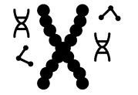
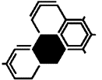
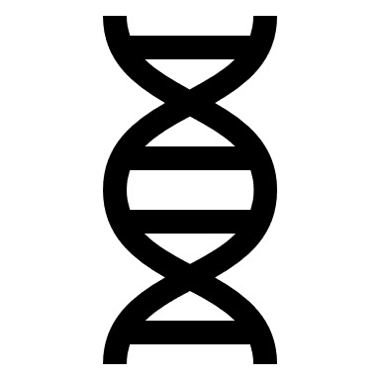
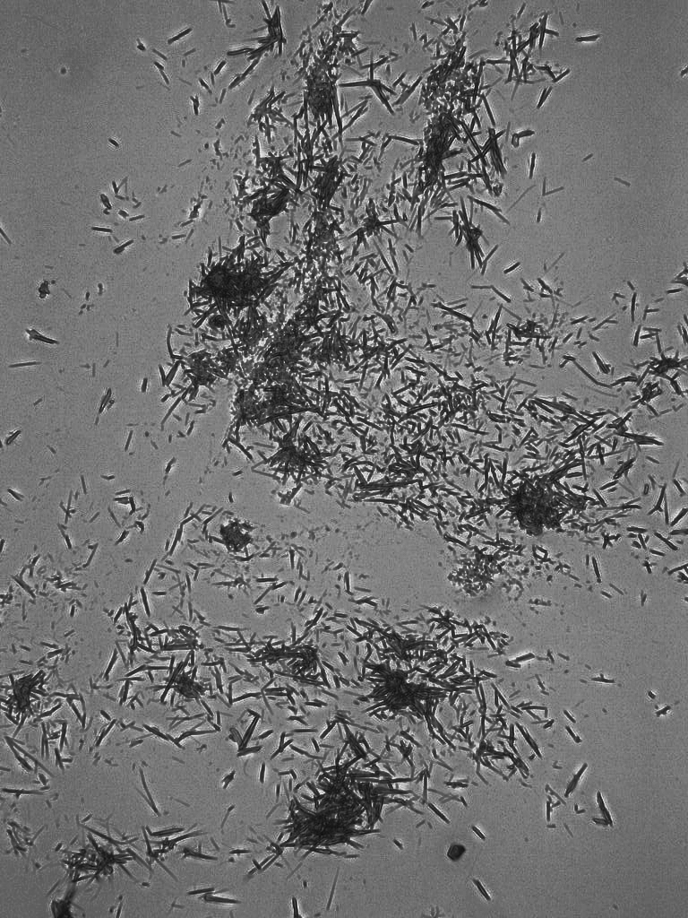
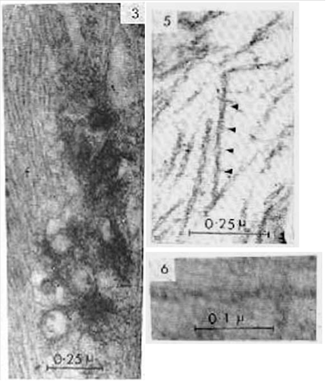
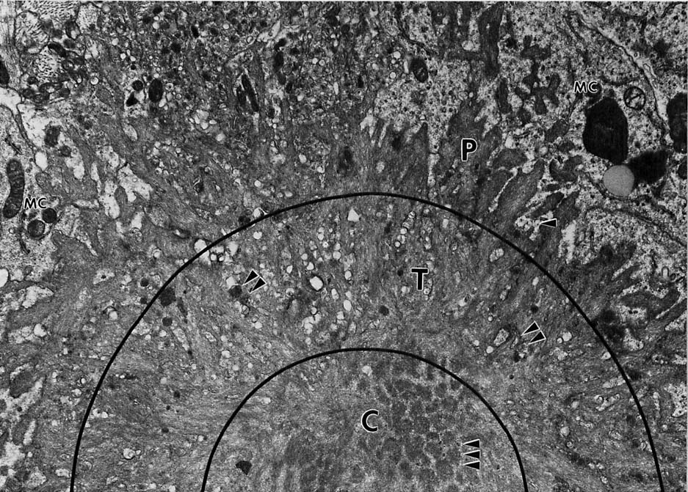
Fiber Bundle Formation in Model Protein for Alzheimer’s Disease
John Leigh, Mariana Mazzocca, Isabella Leon
Faculty Advisor(s): Dr. Shaohua Xu, Dept. of Biological Sciences, Florida Institute of Technology
Abstract
Methods
Results
Fiber aggregation is a prominent characteristic of Alzheimer’s Disease (AD). Understanding fiber aggregation can translate to a better understanding of AD and its treatment. In this lab hydrogels were made using lysozyme to stimulate amyloid plaques found in AD. The gels were then looked at using light microscopy to describe their visual characteristics.
Making Hydrogels
Hydrogels were made using lysozyme at a concentration of 20 mg per ml in glycine buffer. The buffer was comprised of a 10 mM Glycine and 150 mM NaCl at a pH of 2.5. The solution was then incubated at 55° C and 500 rpm until it solidified into a gel.
Imaging with Light Microscopy
1 ml aliquots of hydrogel were centrifuged for 10 minutes at 10,000 rpms. After discarding the supernatant, 1 ml of DI water was added and then the sample was centrifuged again to wash it. This was repeated multiple times. Slides were made of the hydrogels at various dilutions, 10x 100x and 1000x, and looked at under a light microscope to see the bundles.
Imaging with Confocal Microscopy
Following the same procedure for light microscopy with an addition of Tht stanning, the slides were prepared for confocal microscopy.
Background
Alzheimer’s Disease (AD) can be defined as a degenerative disease that causes neuronal loss in the brain and leads to loss of memory and cognitive skills (Xu, 2007). The discovery of plaques led to further studies on abnormal protein fibers in the brain, which are suspected to be an underlying cause of AD. Tau protein aggregates also begin forming after Aβ plaques develop. These tau aggregates develop into neurofibrillary tangles and are massive, 250 nm. The ultimate goal of researchers in the field of diseases is to uncover what specifically causes the neuronal loss in AD, and how it can be prevented. Fibers can be prepared in vitro and analyzed under light or confocal microscopes to understand more about their structure and formation, which will be described.
Figure 3: Light microscope images of hydrogel at 10x dilution under 40x magnification
Discussion
Lysozyme hydrogels were made and examined under light microscopy to better understand the conditions for the creation of these aggregates. This can translate to the formation of Aβ fibers in the brain of AD patients.
Acknowledgements
This project was supported by the Florida Institute of Technology School of Biomedical Science and Dr. Shaohua Xu’s laboratory. Special thanks to Tatiana and the Graduate students of Dr. Shaohua Xu’s laboratory.
References
(Xu, S. et al., 2007). “Aggregation drives ‘misfolding’ in protein amyloid fiber formation.” doi 10.1080/13506120701260059
(Sun, Y, et al., 2021). “Role of the extracellular matrix in alzheimer’s disease.” doi 10.3389/fnagi.2021.707466
(Naseri, N. et al., 2019). “The complexity of tau in Alzheimer’s disease.” doi 10.1016/j.neulet.2019.04.022
Figure 1: Classical amyloid plaques with fiber bundles indicated by arrows
Figure 2: Neurofibrillary Tangle (NFT) of tau protein in neurons

