Slide 1
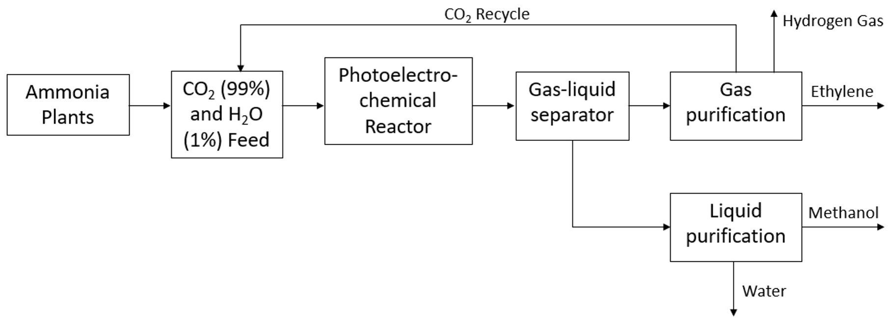
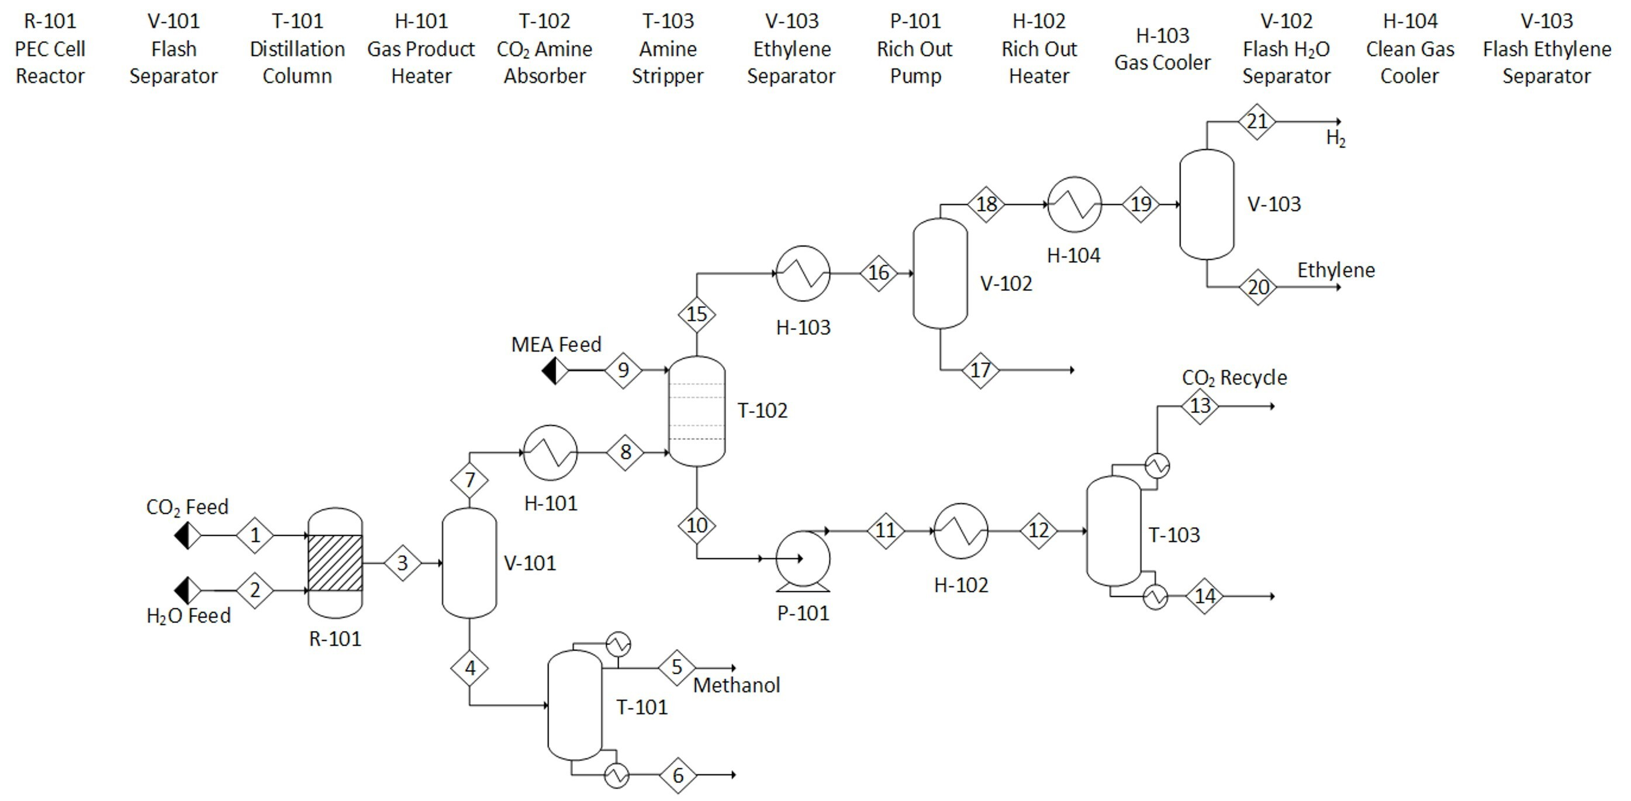
Carbon Dioxide Conversion Using Photoelectrochemical Cells
Maya Derenthal, Jamielyn Jarvis, Wendy Zhou
Faculty Advisor: Dr. Jonathan Whitlow, Dept. of Chemical Engineering, Florida Institute of Technology
ABSTRACT
BLOCK FLOW DIAGRAM
CO₂ production has become one of if not the major contributor to global warming due to continual increase of greenhouse gas emissions caused by anthropogenic activity. Currently, complete transfer from high CO₂ production methods into greener processes is not technically or economically feasible. As an intermediary plan, CO₂ conversion processes are a viable option to pursue to not only tackle CO₂ emissions but also produce highly valuable chemical feedstocks used in industry.
MOTIVATIONS
PROCESS FLOW DIAGRAM
The goal of this project is to successfully simulate a production plant that utilizes an array of photoelectrochemical cell (PEC) alongside TiO₂ nanoparticle catalyst to produce methanol, ethylene, and hydrogen gas. Simulation will be done in Aspen Plus, assuming a 10-year plant life, with a costing and economic analysis having been completed.
NOVELTY
TiO₂ nanoparticles synthesized in supercritical medium to be used as catalyst (SC-TiO₂)
Membrane Electrode Assembly (MEA) coupled with anode of PEC
Constant supply of CO₂ to PEC
Greener production process compared to current practices for methanol, ethylene, and hydrogen
REACTIONS
PHOTOELECTROCHEMICAL CELL
Cathode
2CO₂ + 12H⁺ + 12e⁻ → C₂H_{4(g)} + 4H₂O
CO₂ + 6H⁺ + 6e⁻ → CH₃OH_{(l)} + H₂O
2CO₂ + 12H⁺ + 12e⁻ → C₂H₅OH_{(l)} + 3H₂O
2H⁺ + 2e⁻ → H_{2(g)}
Anode
2H₂O → 4H⁺ + 4e⁻ + O_{2(g)}
Merino-Garcia, Ivan, et al. “Efficient Photoelectrochemical Conversion of CO₂ to Ethylene and Methanol Using a Cu Cathode and TiO₂ Nanoparticles Synthesized in Supercritical Medium as Photoanode.” Journal of Environmental Chemical Engineering, vol. 10, no. 3, June 2022, p. 107441. ScienceDirect, https://doi.org/10.1016/j.jece.2022.107441.

