Slide 1
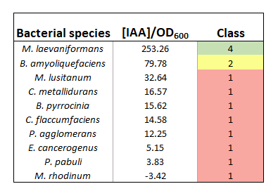
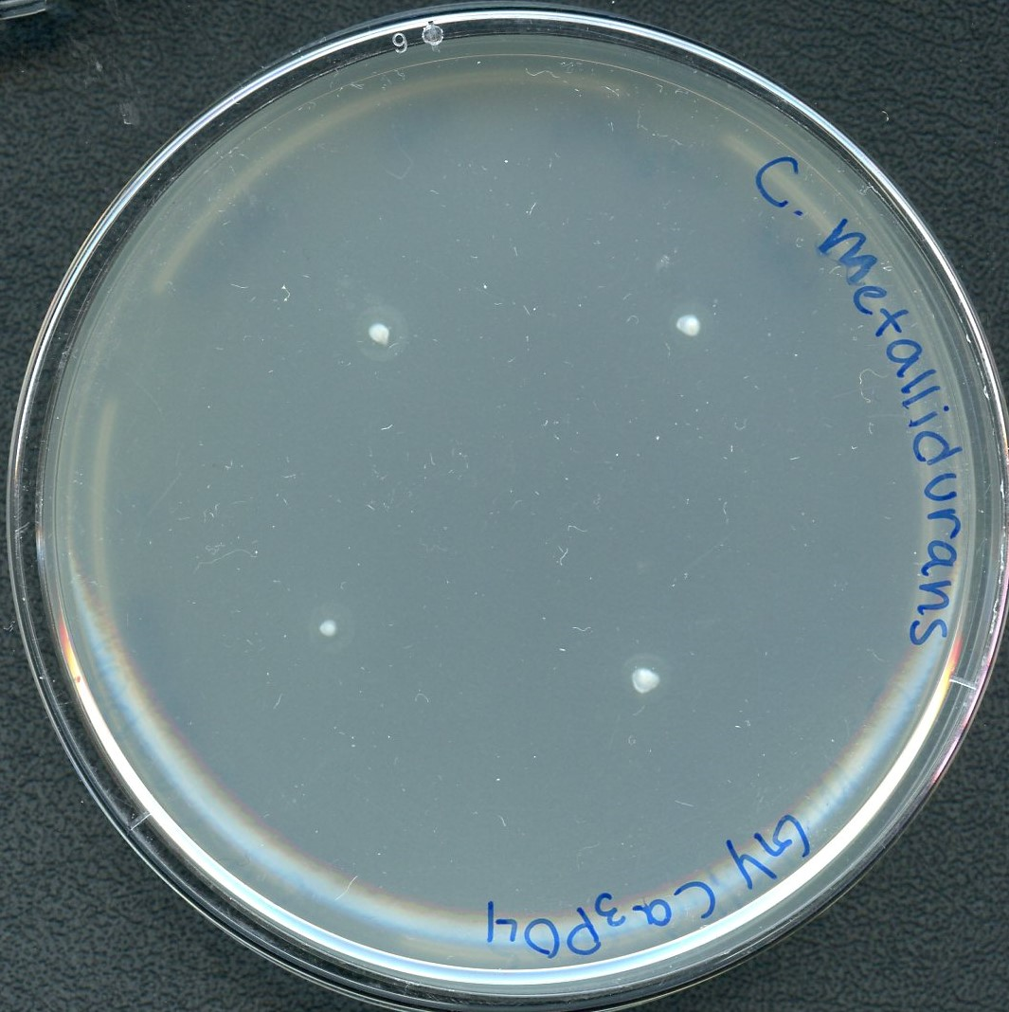
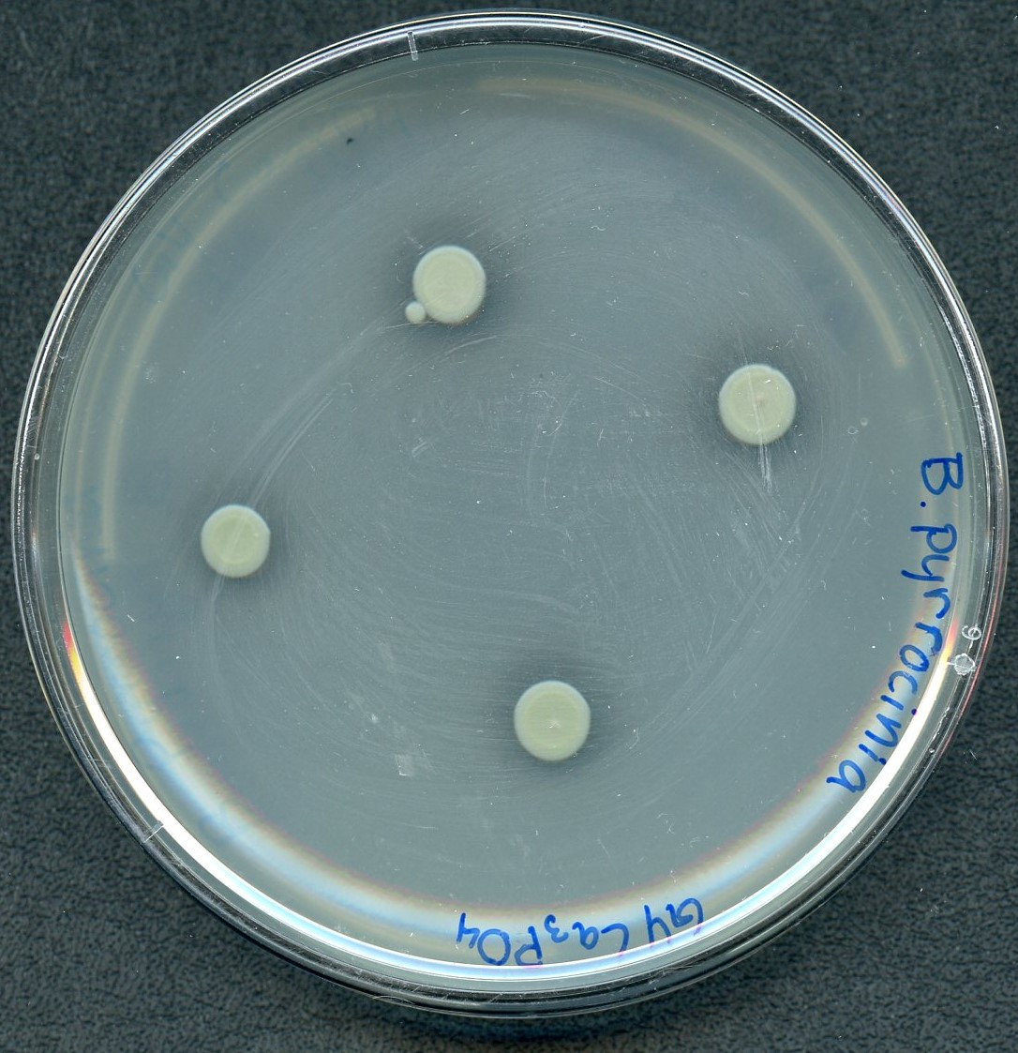
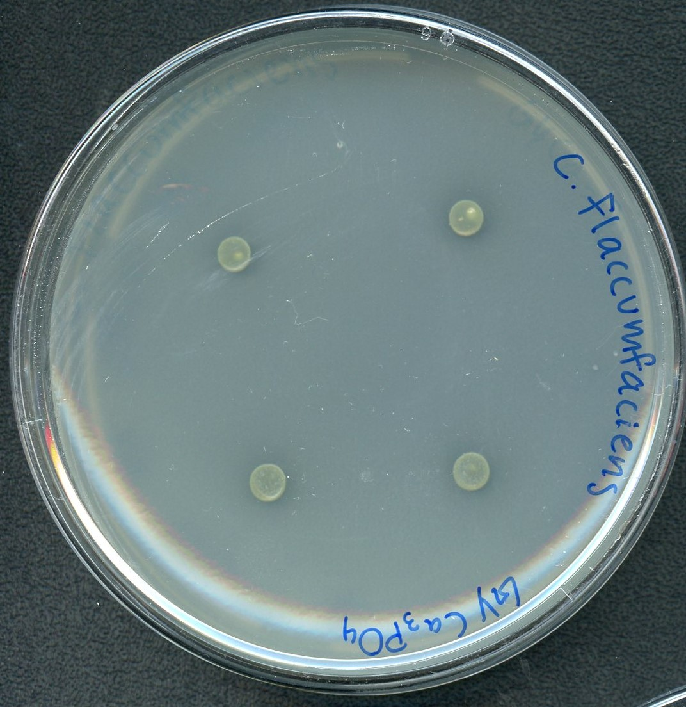
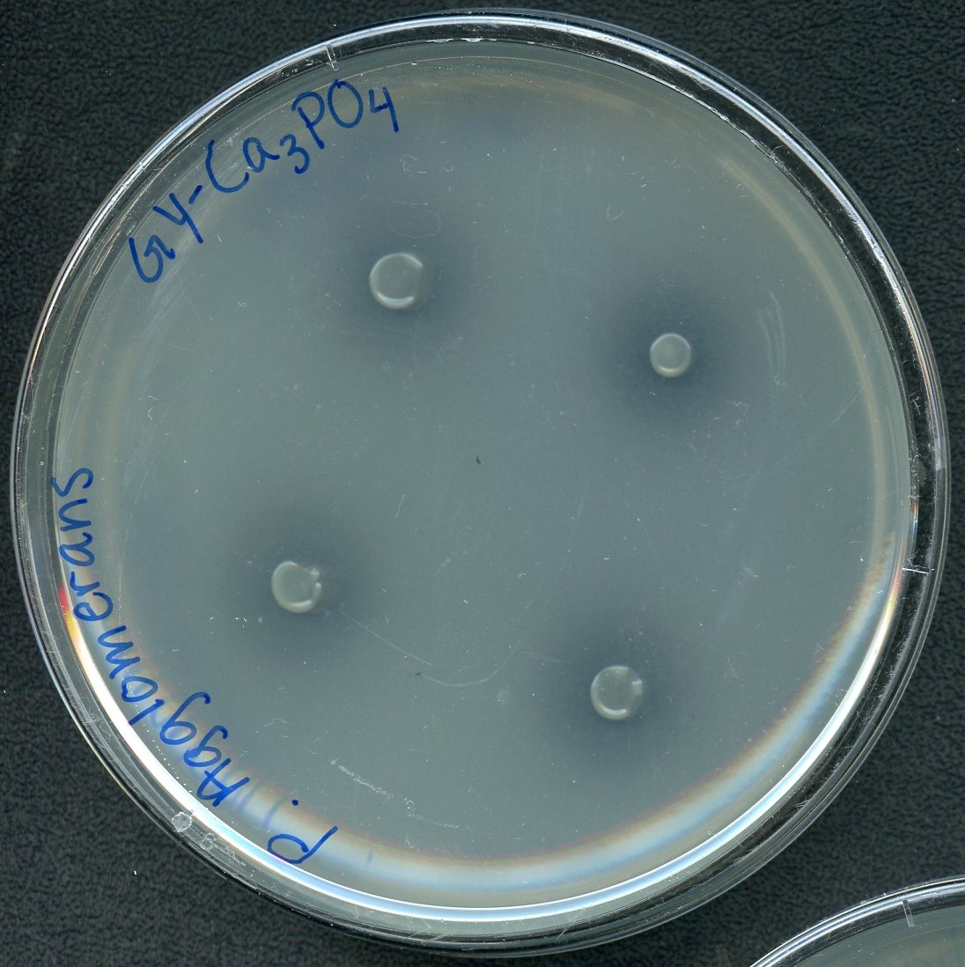
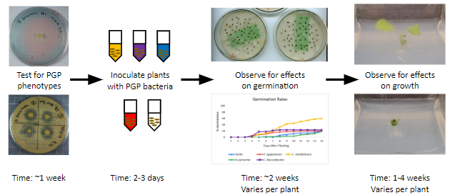
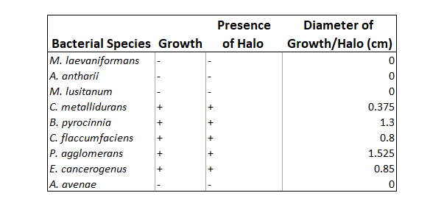
Screening and Identification of Potential PGP Microorganisms with Spaceflight History
Kristina Kowalik, Natalie Kerber, David Handy
Faculty Advisor: Dr. Andrew G. Palmer, Dept. of Ocean Engineer and Marine Sciences, Florida Institute of Technology
BACKGROUND
METHODS
Human colonization of space will require the on-site production of plants to provide a food source, as resupply missions will become increasingly difficult. Microgravity environments, however, pose unique challenges for successful plant growth.
Plant growth promoting (PGP) microorganisms can facilitate plant growth, improve nutrient uptake, and improve resistance to potential plant pathogens, providing a potential solution to the environmental challenges of space.
We hypothesize that bacterial isolates from the VEGGIE crop production system were ideal in determining PGP bacteria, as they already have a spaceflight history.
Here, we evaluated bacterial isolates from the VEGGIE crop production system by a series of biochemical assays to determine if they expressed PGP phenotypes.
Tricalcium Phosphate Solubilization Assay
Bacterial species were inoculated in King's B medium for 48 hours (with shaking)
Samples were spot six times onto a GY/tricalcium phosphate plate and incubated for seven days
Halo diameters formed were measured
Indolic Compound Production Assay
Bacterial species were inoculated in a King's B-tryptophan media and incubated for 48 hours (with shaking)
Samples were centrifuged and supernatant collected to record optical density at 600 nm
A colorimetric assay was performed
Each bacterial sample was run through the spectrometer using triplicate samples
RESULTS
Table 1: Indoleacetic acid production values and classifications. Classification ranges are as follow: 1: <50, 2: 50-100, 3: 100-200, 4: >200.
Figure 2: Tricalcium Phosphate plates after incubation. The results for C. metallidurans, B. pyrrocinia, C. flaccumfaciens, and P. agglomerans are shown.
CONCLUSIONS/FUTURE STUDIES
C. metallidurans, B. pyrocinnia, C. flaccumfaciens, P. agglomerans, and E. cancerogenus grew on the tricalcium phosphate, indicating that they solubilize phosphate (Table 2, Figure 2).
Only M. laevaniformans shows significant indole production (Table 1).
Bacteria identified as having PGP properties will have these phenotypes tested in simulated microgravity to determine if this would occur on the ISS.
These bacteria will also go through studies on their effectiveness as PGP inoculants, to verify their potential utility.
Figure 1: The Testing Pipeline as designed by David Handy (2022). Biochemical assays act as the first step in creating microbial mixtures in support of space agriculture
REFERENCES
Handy, D., Hummerick, M. E., Dixit, A. R., Ruby, A. M.,
Massa, G., & Palmer, A. (2021). Identification of plant growth promoting bacteria within space crop production systems. Frontiers in Astronomy and Space Sciences, 183.
Table 2: Tricalcium Phosphate Solubilization Assay results. Bacterial growth with the presence of a halo indicates that the bacterial species can solubilize Phosphate.

