Slide 1
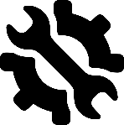
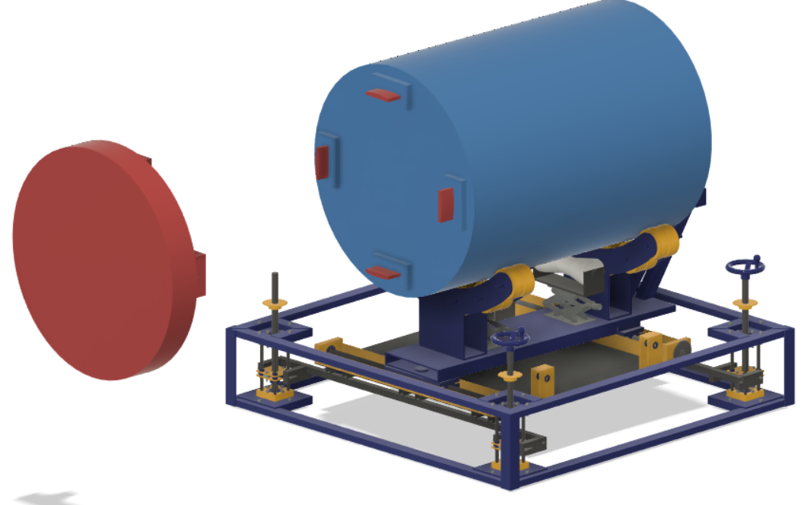
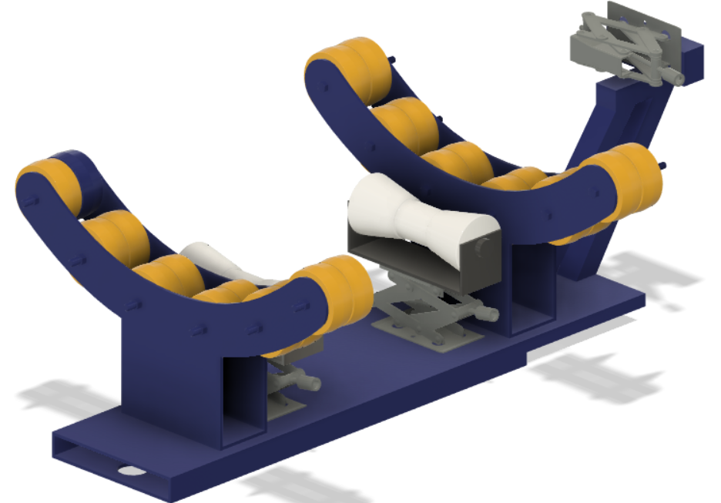
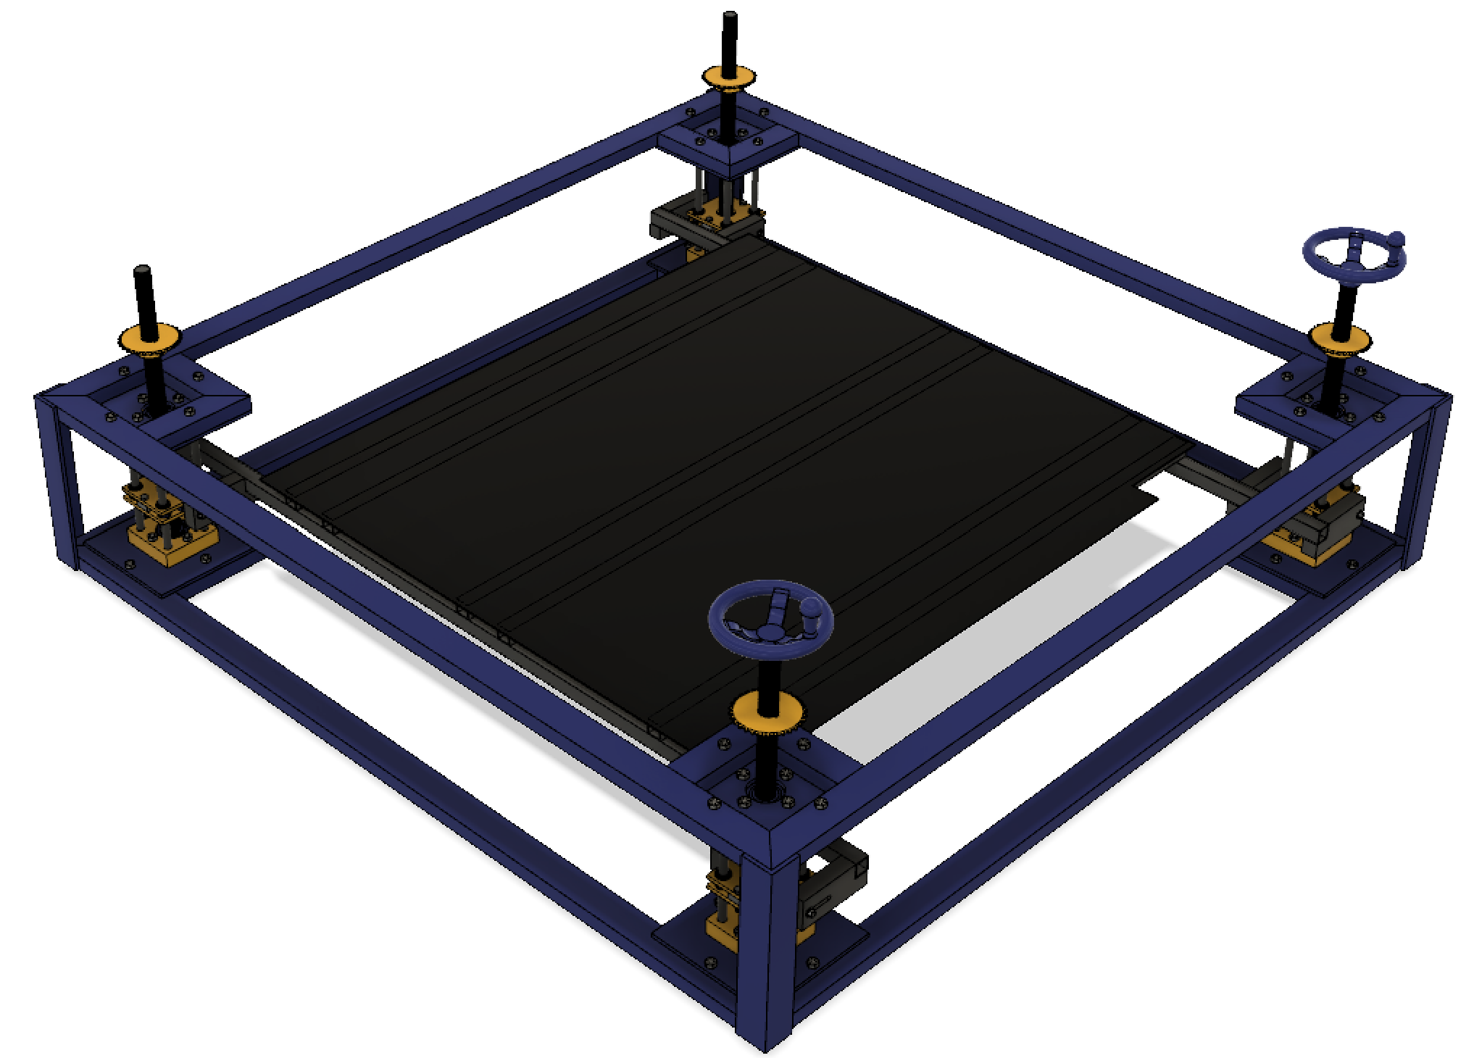
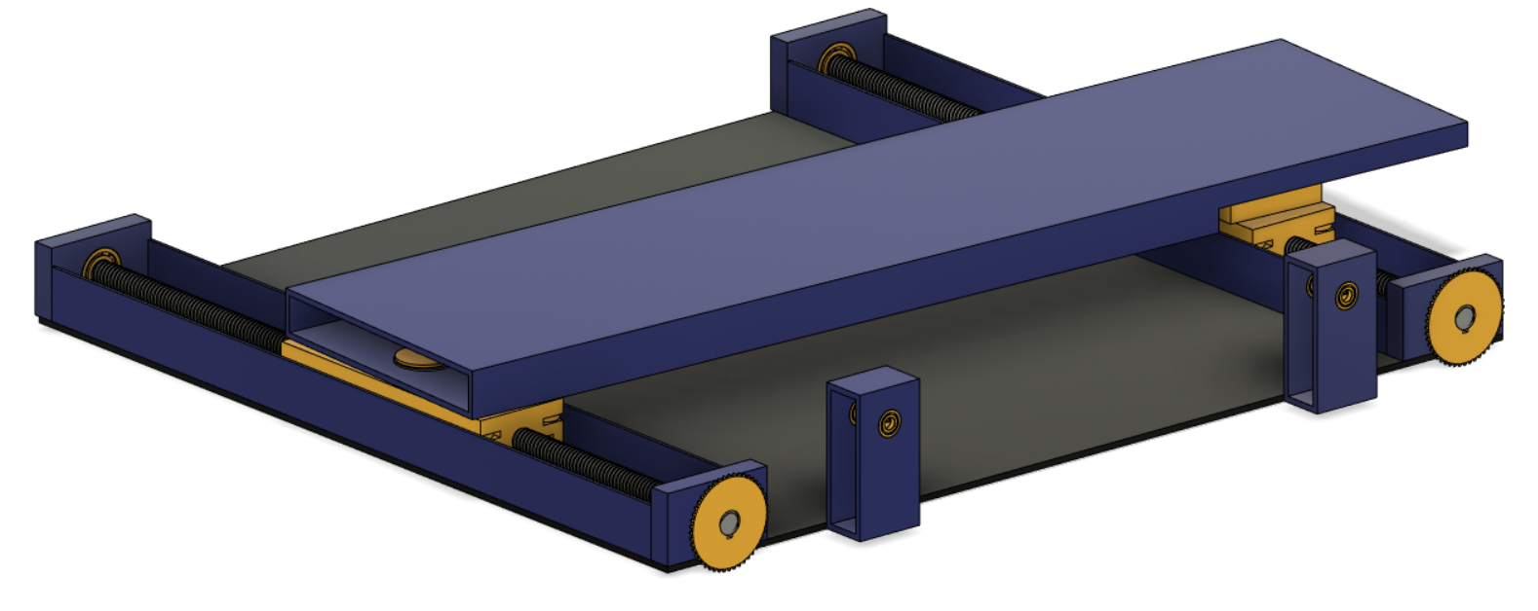
Cylinder Mating System (CMS)
Tresor Djaffah Digba, Sam Hefner, Lindsey Kahn, Daniel Longo, Guy Mpendaga Igondjo, Rebecca Nadeau, Rahlyn Ramsaran, Maria Roelant
Faculty Advisor: Dr. Douglas Willard, Dept. of Mechanical Engineering, Florida Institute of Technology
Problem Statement
Loaded CMS CAD Model
Manufacturing Methods
This project will design, analyze, and demonstrate a device capable of maneuvering a large Cylinder with high precision in six degrees of freedom to a static mating surface.
The CMS will allow a single user to align an undefined large cylindrical object to its matching Stationary Member to connect the two via a prong interface. Due to the variable external conditions, the CMS will be manually operated and will not require additional power sources.
To manufacture the CMS, multiple machining methods were used. A circular saw, manual mill, and MIG welding were used to machine the External and Center Frame of the Riser Assembly. A CNC mill, water jet, and hydraulic press were used for the Lead Screw assemblies and Slider Carts. A plasma cutter and manual lathe were used for the Cradle Assembly and Support Beam.
Future Work
Further development of this project would be implementing more traceability and adding hydraulics. Due to the small increments of desired movement for this project, lead screws are used for precise movement; however, for a larger scale project, hydraulics would create a more accurate and consistent system.
Design and Analysis Methods
The CMS is broken into three sub-assemblies, each addressing two degrees of freedom. Each CMS sub-assembly was carefully designed to function precisely and meet the structural integrity requirements given by the customer. To satisfy the requirements, the CMS designs were modeled and analyzed in Fusion 360 with some additional structural analysis performed in Ansys. The structural integrity requirements state the CMS shall have a minimum yield FOS of 1.5 and an ultimate FOS of 2.
CMS Cradle Assembly
Controls the Roll and X-Position of the Cylinder
Contains U-shaped cradles that contact a small portion of the Cylinder, while providing maximum support
Utilizes scissor jacks for precise movement
Acknowledgements
We would like to give a huge thank you to both Lockheed Martin and the U.S. Navy for sponsoring this project and to Maria Rush, Jake Miller, Felix Gabriel, Ethan Bair, Dr. Douglas Willard, and Bill Bailey for their continued assistance and support throughout this project.
CMS Slider Assembly
CMS Riser Assembly
Controls the Yaw and Y-Position of the Cylinder
Contains a ‘Top Hat’ design that prevents the Support Beam from binding during the Yaw adjustment
Utilizes lead screws with a 3:1 gear ratio for high precision
Controls the Pitch and Z-Position of the Cylinder
Contains Lead Screw Assemblies that prevent back drive, while supporting the weight of both the Cylinder and other assemblies

