Slide 1
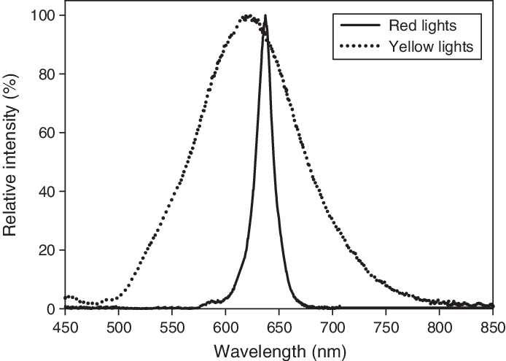
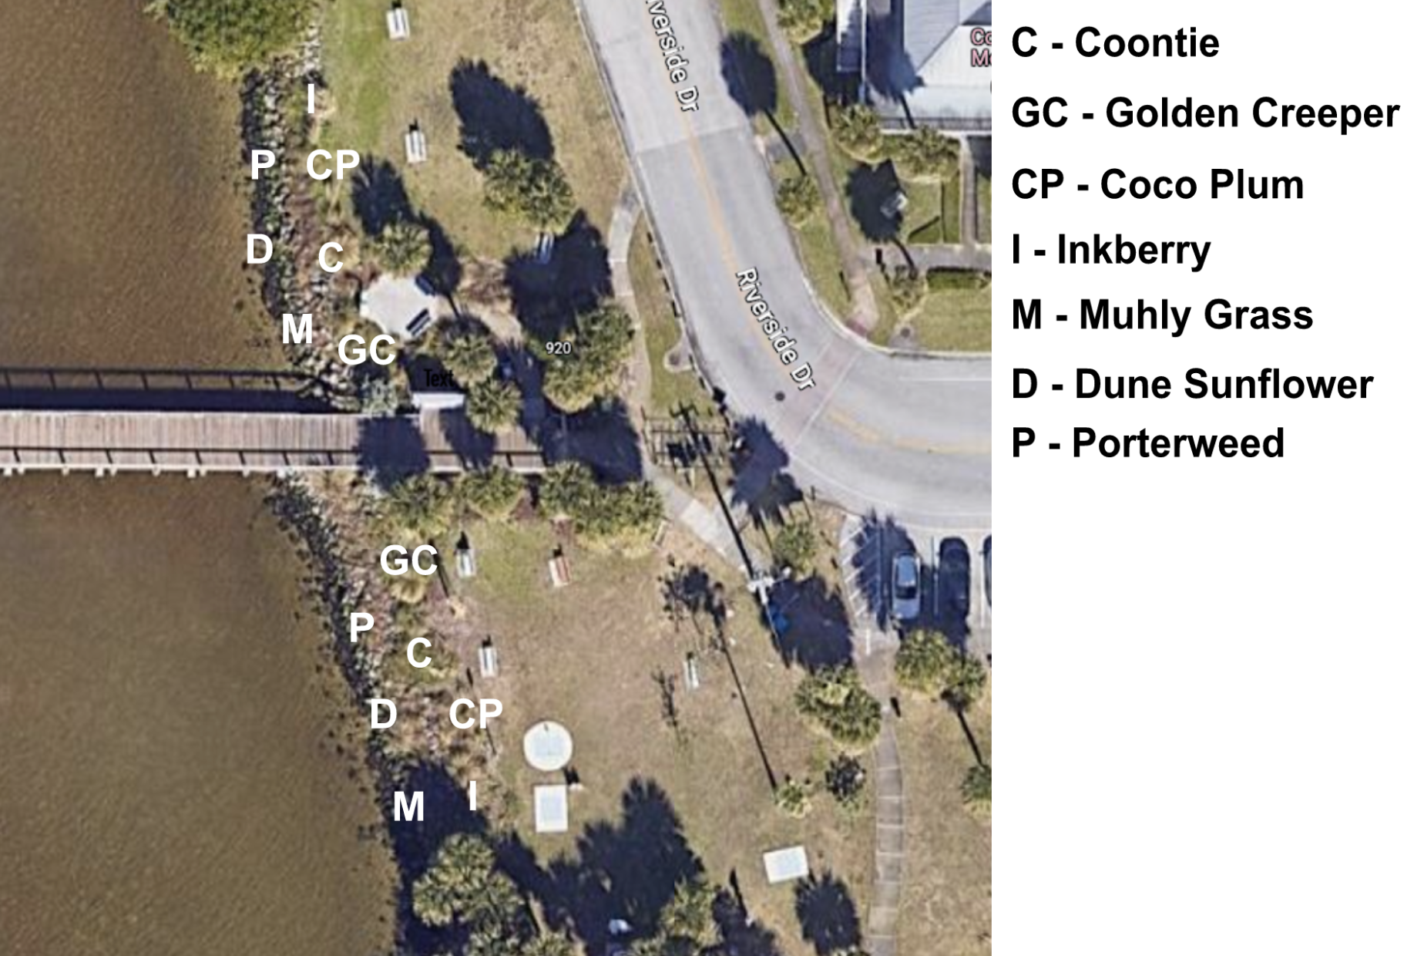
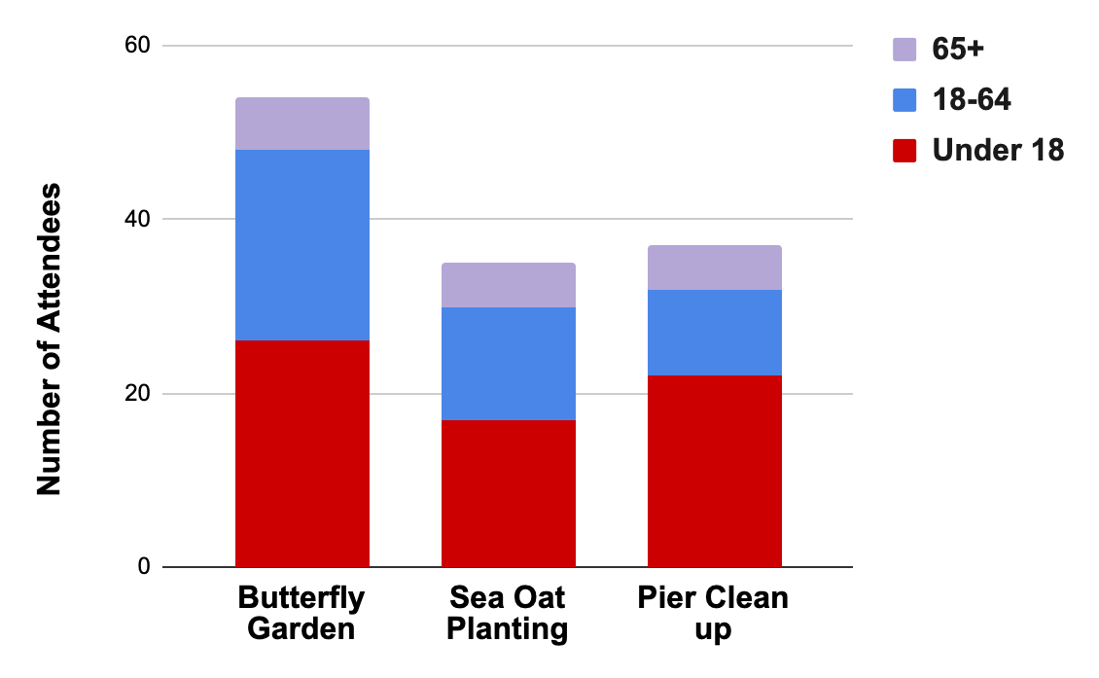
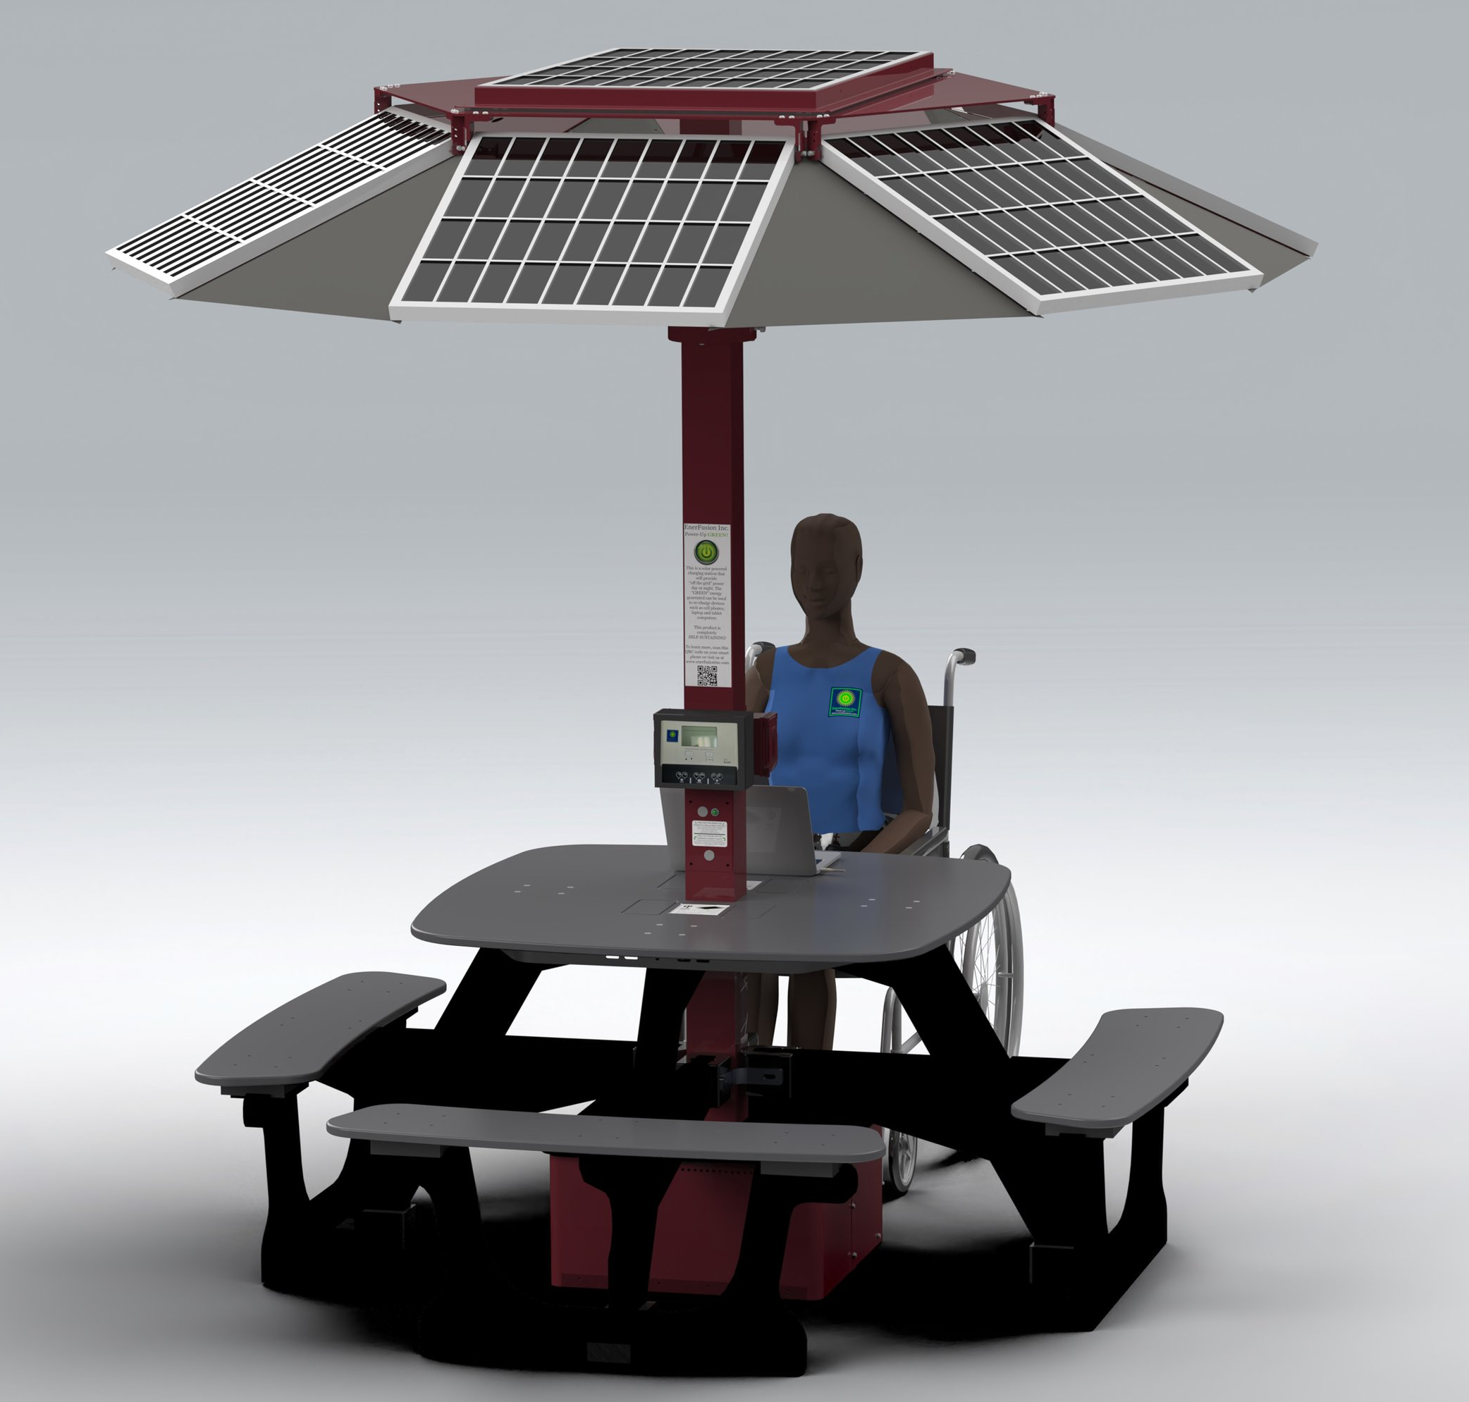
Ordinance Development, Grant Writing, and Outreach to Advance Sustainability in the Town of Melbourne Beach, FL Reese C. Johnson
Faculty Advisor: Dr. Ken Lindeman, Dept. of Ocean Engineering & Marine Sciences, Florida Tech
Introduction
The Town of Melbourne Beach, FL, borders the Indian River Lagoon (IRL) and the Atlantic Ocean, and faces challenges from a changing climate and development pressures. This project continues actions proposed in the town’s Sustainability Action Plan¹. The town’s Environmental Advisory Board (EAB) is particularly focused on grants for landscaping and clean energy education, ordinance revisions, and community outreach.
Objectives
To apply for two grants which would develop a solar table project and an upland buffer project.
To work with the Sea Turtle Conservancy to develop a new lighting ordinance.
To engage the community by advertising and hosting sustainability events.
Methods
Grant Applications
Apply for a One Lagoon grant to fund an upland buffer² to limit nutrient inflows into the IRL.
Apply for a Dept. of Energy grant for 2 solar tables that charge all electronic devices. Both grants are for Ryckman Park.
Lighting Ordinance
Through meetings and follow-ups, develop a revised town lighting ordinance with the Sea Turtle Conservancy (STC).
Work with the EAB to ensure the town’s specific objectives for this ordinance are achieved.
With EAB approval, forward the ordinance to the town council for a vote by summer or fall 2023.
Community Outreach
Develop marketing that invites the town residents to sustainability education events.
Develop sustainability events for Founder’s Day and other activities to educate the public.
Results
Grant Applications
The proposed upload buffer at Ryckman Park will consist of native shrubs and ground cover (Fig. 1).
Fig. 1: Aerial sitemap for the upland buffer
The second grant is requesting two solar charging tables from Enerfusion Incorporated (Fig. 2) in high traffic areas. The tables charge any device, day or night, and have sensors for night lighting.
Fig. 2: Solar charging table with panels & console²
Lighting Ordinance
The proposed revisions to lighting ordinance the change the focus from regulating intensity to wavelength. The minimum wavelength permissible is 560 nanometers (Fig. 3).
Results (cont.)
Fig. 3: Red light is less common & preferred for turtles³
Community Outreach
The outreach events attracted 124 total volunteers, ranging from 35 to 52 people per event (Fig. 4), many under age 18. Volunteers gained knowledge of applied town-scale landscaping and sustainability actions.
Fig. 4: Attendance for three outreach events
Discussion
The grant projects will advance sustainability actions at the town’s premier public park in terms of solar education and runoff reduction. The new ordinance, if approved, will help reduce adult and hatchling sea turtle mortality. Three sustainability outreach events reached a wide-ranging audience. Another intern in 2023-24 can expand SUS actions.
References
¹ Sustainability Action Plan, Mel. Bch. 2019.
² Enerfusion website. Mar 2023.
³ Robertson et al. 2016. Wildlife Research.
Acknowledgements
Thank you to the EAB, the STC , Elizabeth Mascaro and Sarah Brooks.
Specifications
2 110 vac 60 Hz GFCI outlets
4 USB Type “A” power outlets
Dual-Port High-Speed USB-C Charger Ports
4 Wireless Chargers on top surface

