Slide 1
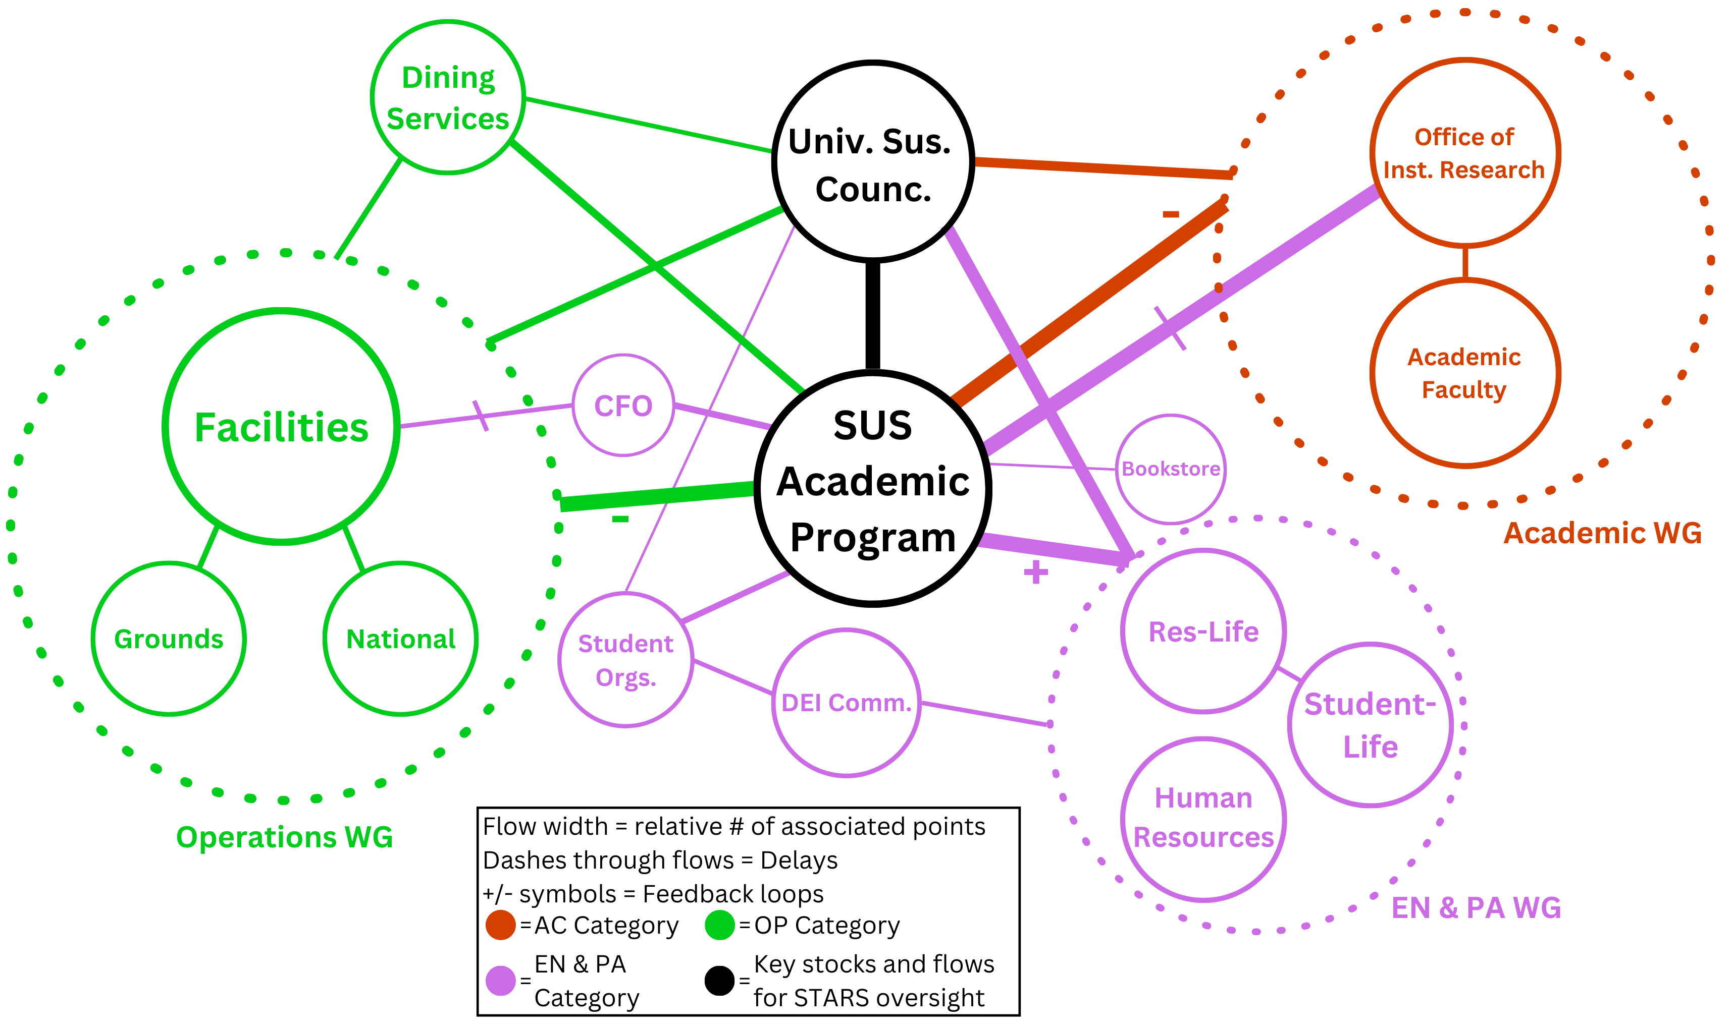
Campus-wide Sustainability Recertification Focusing on 30 STARS Engagement and Planning Credits, Florida Tech Christian Foster
Faculty Advisor: Dr. Ken Lindeman, Dept. of Ocean Engineering & Marine Sciences, , Florida Tech
Introduction
Florida Tech has been the source of many innovations, yet new challenges have created a focus on campus sustainability actions. This project focuses on achieving credits in the STARS 3-year certification process¹ that Florida Tech employs to aid campus innovations and establish baselines for sustainability performance measurement.
Objectives
To assemble workgroups (WGs) to delegate workloads and optimize points for credits.
To achieve maximum overall points in the Engagement (EN) Category.
To achieve maximum overall points in the Planning & Administration (PA) Category.
Methods
Optimizing STARS Workflows
Re-aligned and re-engaged existing WGs from the University Sustainability Council (USC).
Merged the USC’s EN and PA category WGs due to heavy overlap in membership and content.
Expanded involvement of students, including student employees and organizations.
Actions to Achieve Engagement Points
An inventory was made of past points achieved, and potential new points were estimated.
11 EN credits were identified for priority actions.
>30 data-mining or other actions were completed.
Depending on credit details, >6 specific campus partnerships were continued or catalyzed to satisfy measurable criteria.
Actions to Achieve Planning & Admin. Points
An inventory was made of past points achieved, and potential new points were estimated.
10 PA credits were identified for actions.
>20 data-mining or other actions were completed.
Depending on credit details, actions with >4 partners were continued or catalyzed to satisfy measurable criteria.
Results
Optimizing STARS Workflows
The most important campus offices for completion of certification included: Facilities, Student-Life, Office of Institutional Research and the SUS Academic Program (Fig. 1).
The width of the flow-lines indicates the relative volume of information transfer; e.g., the inter-actions of the USC and, SUS Academic Program.
Actions to Achieve Engagement Points
Up to 6 additional points are expected to be added due to efforts undertaken in the EN category during the project (Fig. 2). In the EN category, we have been able to keep 95% of the points from the 2020 report (18.5 points).
Actions to Achieve Planning & Admin. Points
As seen in Fig. 3, at least 1 new point may also be added from PA 6. 60% of the points for the PA category were maintained from the 2020 report (8.25 points).
Results, cont.
An additional 35% (4.81 points) may be maintained by the recertification due date.
Discussion
The recertification is due in Nov. 2023. To advance from our prior Silver to a Gold STARS rating, an increase of approx. 15 pts to 65 total is needed².
The work done during the project has identified areas, such as PA credits, where more data is still needed to determine final points (Fig. 4).
The primary point increases included the Trick-or-Trash program, as well as new AC and EN surveys.
Literature Cited
¹ STARS Home Page, https://stars.aashe.org/
² FIT STARS Report. 2020. https://.aashe.org/
Acknowledgements
Florida Tech Facilities, many on the USC and its WGs, and others on campus. Sarah Brooks, TA.
Fig 3: Points per PA category, 2020 compared to 2023
Fig 1: Relationships among stocks and flows for STARS credits
Bronze Rating
Silver Rating
Gold Rating?
Fig 4: Point increases by category over three certification cycles
Fig 2: Changes in EN points per credit for 2 certification cycles

