Slide 1
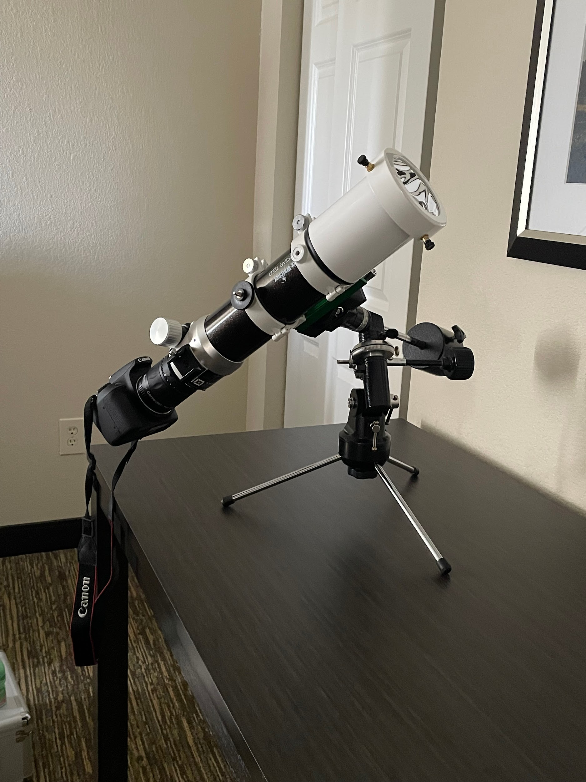
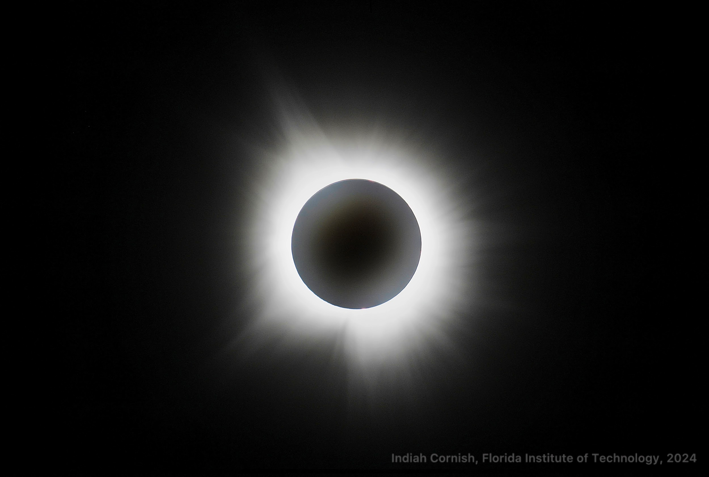
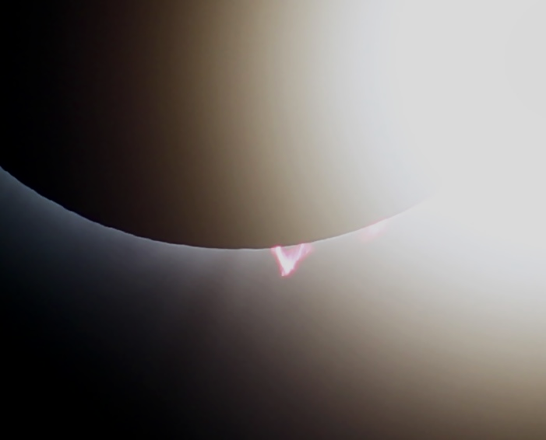
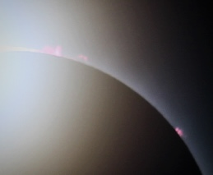
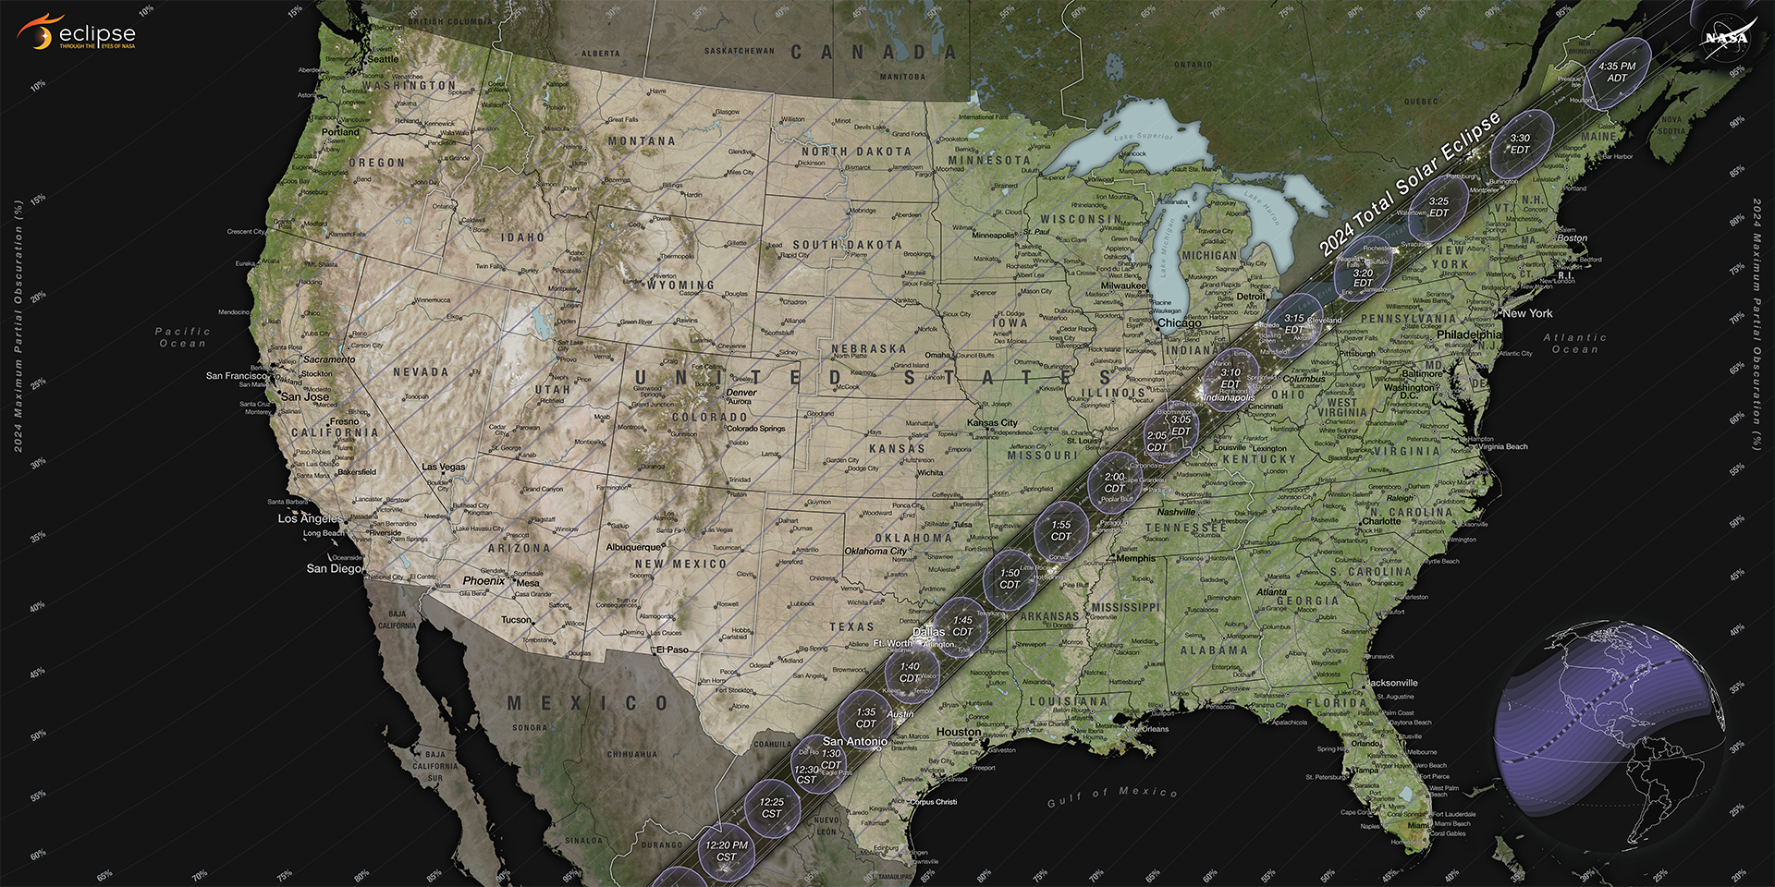
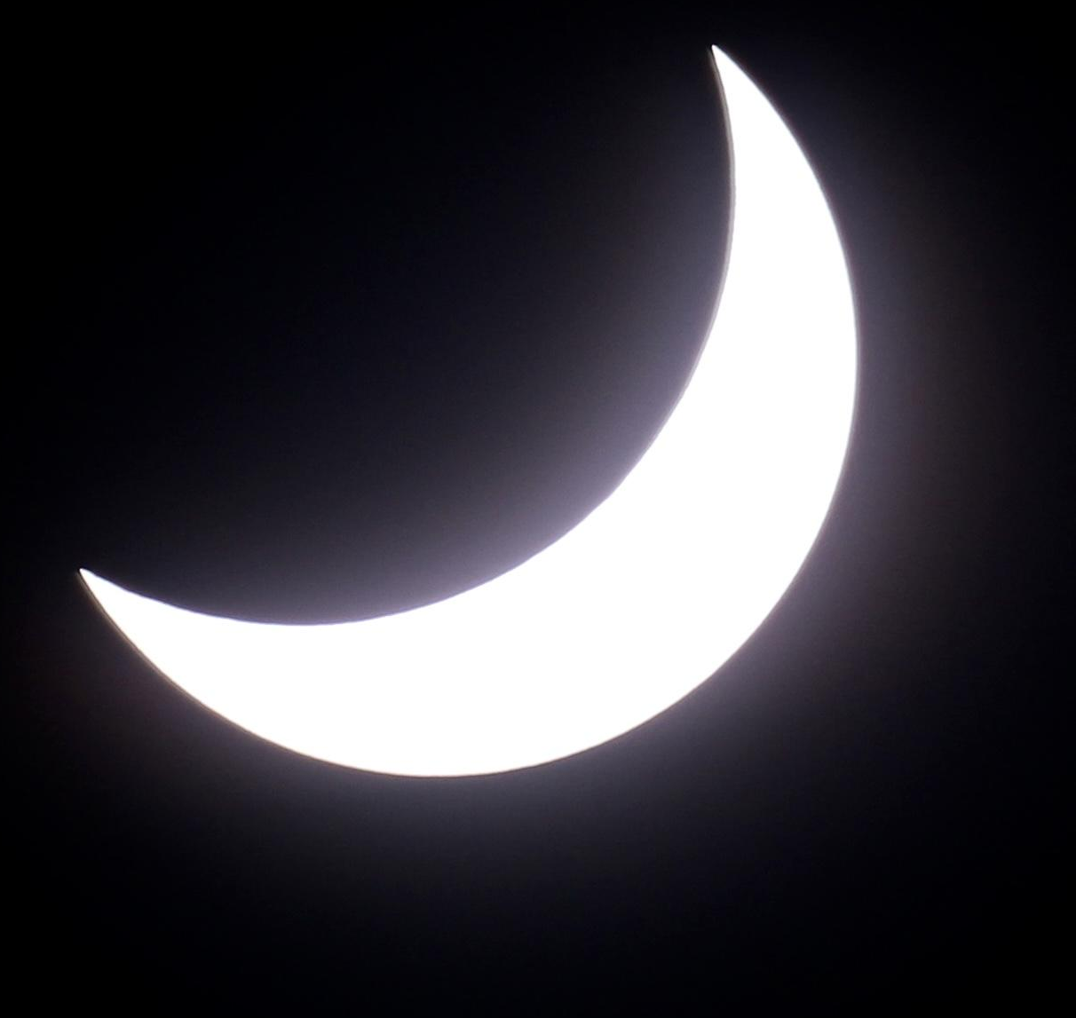
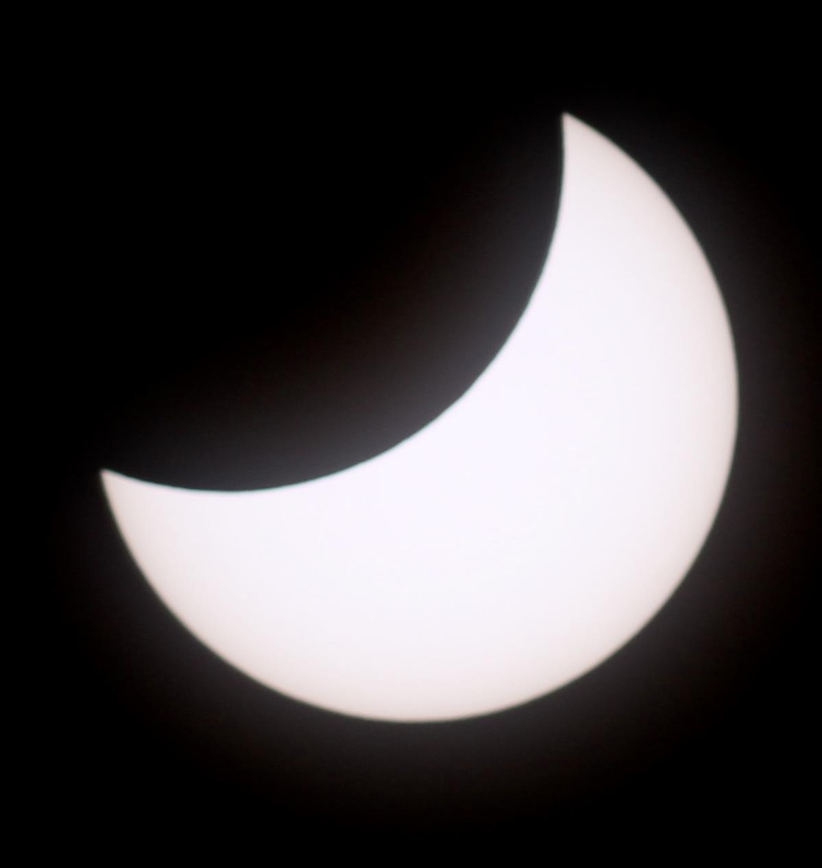
Observational Study of the Solar Corona During a Total Solar Eclipse
Indiah Cornish
Faculty Advisor: Dr. Juan Carlos Palacios, Dept. of APSS, Florida Institute of Technology
Advisor: Leslie Garrison, Heliophysics Lead, NASA Goddard Space Flight Center
INTRODUCTION
The outer atmosphere of the Sun is known as the solar corona. The corona is approximately 10 million times less dense than the surface of the Sun, making it much dimmer than the surface. Therefore, the corona can only be seen from Earth with the assistance of a coronagraph, an instrument designed to block out the direct light from a star. A solar eclipse, in which the Moon’s orbit passes between the Earth and the Sun, is a natural coronagraph, blocking out enough of the Sun’s light that the outer atmosphere can be seen. On April 8th, 2024, a solar eclipse was visible across North America in a strip called the Path of Totality (Figure 1). This observational study was conducted in Indianapolis (IN), one of the cities in the path.
Figure 3: Composite Image, Totality
Figure 2: Photographing Eclipse using Telescope and Camera
During totality, when the Moon was completely obstructing the light from the Sun, the solar filter was removed.
A composite image was then created by overlaying multiple images on top of each other, compiling them into one image.
Figure 4: Close Up Shots, Solar Prominences
CONCLUSIONS
This study provided a rare opportunity to observe the Sun’s outer atmosphere from Earth, shedding light on its dynamic nature and evolving structures.
The results will provide valuable input for models of solar activity and space weather forecasting, enhancing our ability to predict and mitigate the impact of solar events on Earth.
RESULTS
450 images were taken in 7 different periods: Full Sun, First Contact, Second Contact, Totality, Third Contact, Fourth Contact, and then Full Sun once again (Figure 5).
During totality, 50 images were taken and a composite photograph was produced using 10 images (Figure 3).
In the composite image, clear streams of magnetic field and magnetic structures can be observed.
Some surface effects of the Sun, knowns as solar prominences, can be observed in the Second and Third Contact photos (Figure 4).
Figure 1: Path of Totality, svs.gsfc.nasa.gov
METHODOLOGY
Images of the solar eclipse were taken using a Canon Rebel T7 model camera attached to a Sky-Watcher EvoStar 72mm refractor telescope, with a reducer/field flattener (Figure 2).
During the partial phases of the eclipse, an AstroZap solar filter was attached to block out the light from the Sun.
ACKNOWLEDGEMENTS
Dr. Luis Quiroga-Nunez, Ortega Observatory, Florida Institute of Technology.
NASA Heliophysics Outreach Team.
Nicolas Lefaudeux, HDR Astrophotography.
1:50 PM
2:30 PM
2:50 PM
3:05 PM
3:07 PM
3:09 PM
3:19 PM
3:50 PM
4:30 PM
Figure 5: Progression of April 8th, 2024, Solar Eclipse - Eastern Time (ET)

