Slide 1
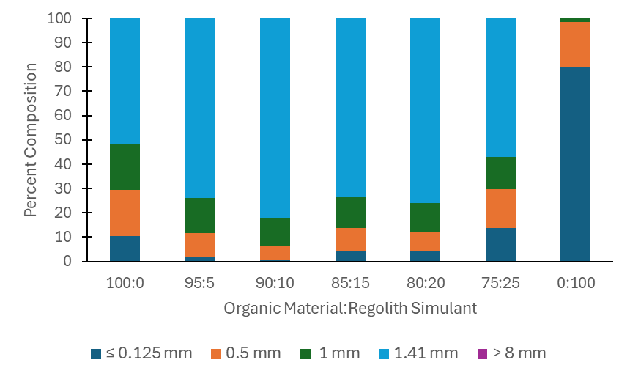
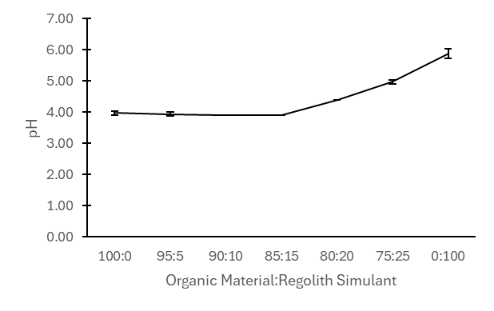
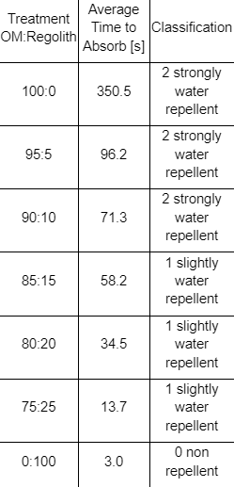
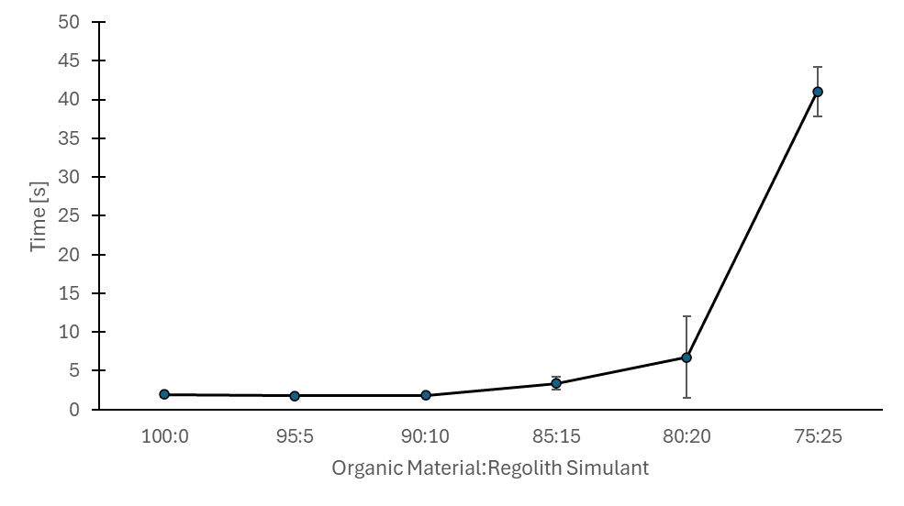
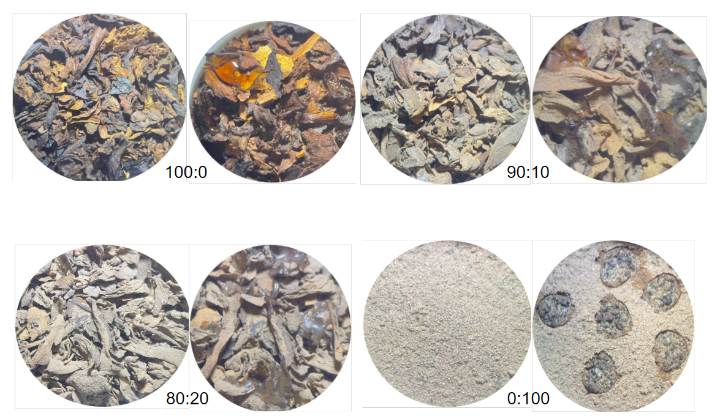
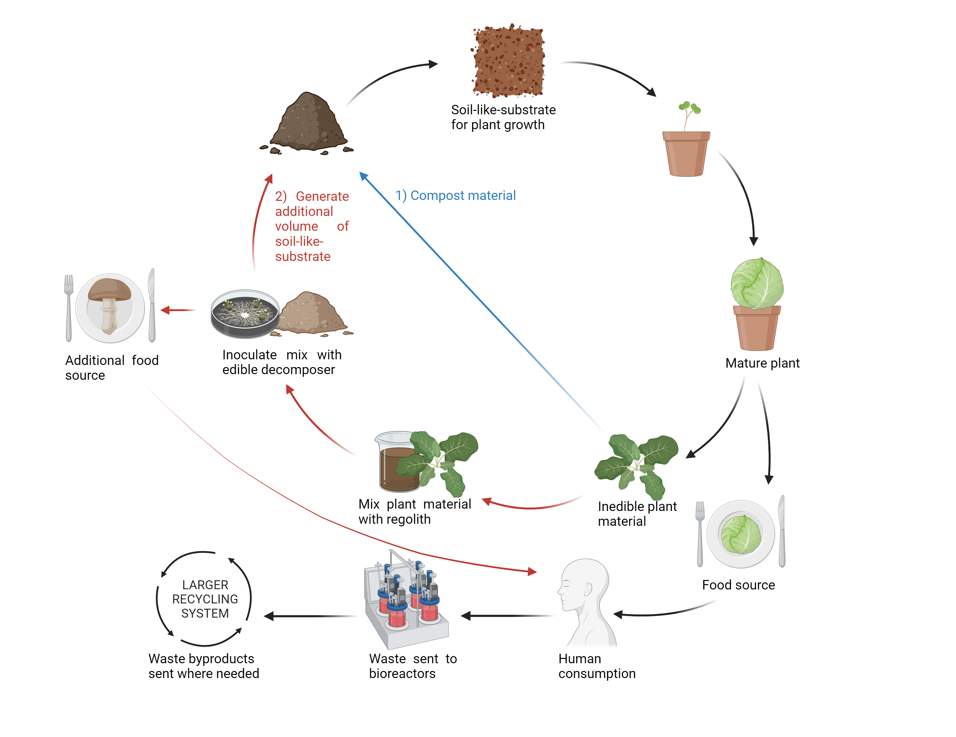
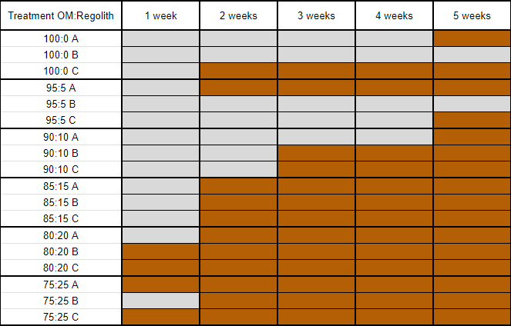
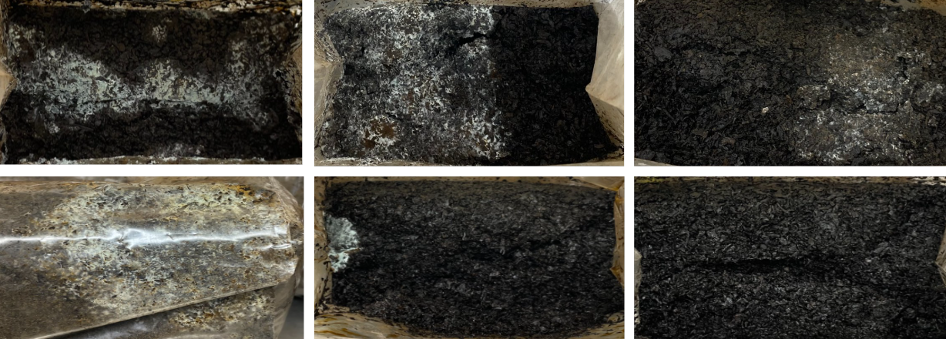
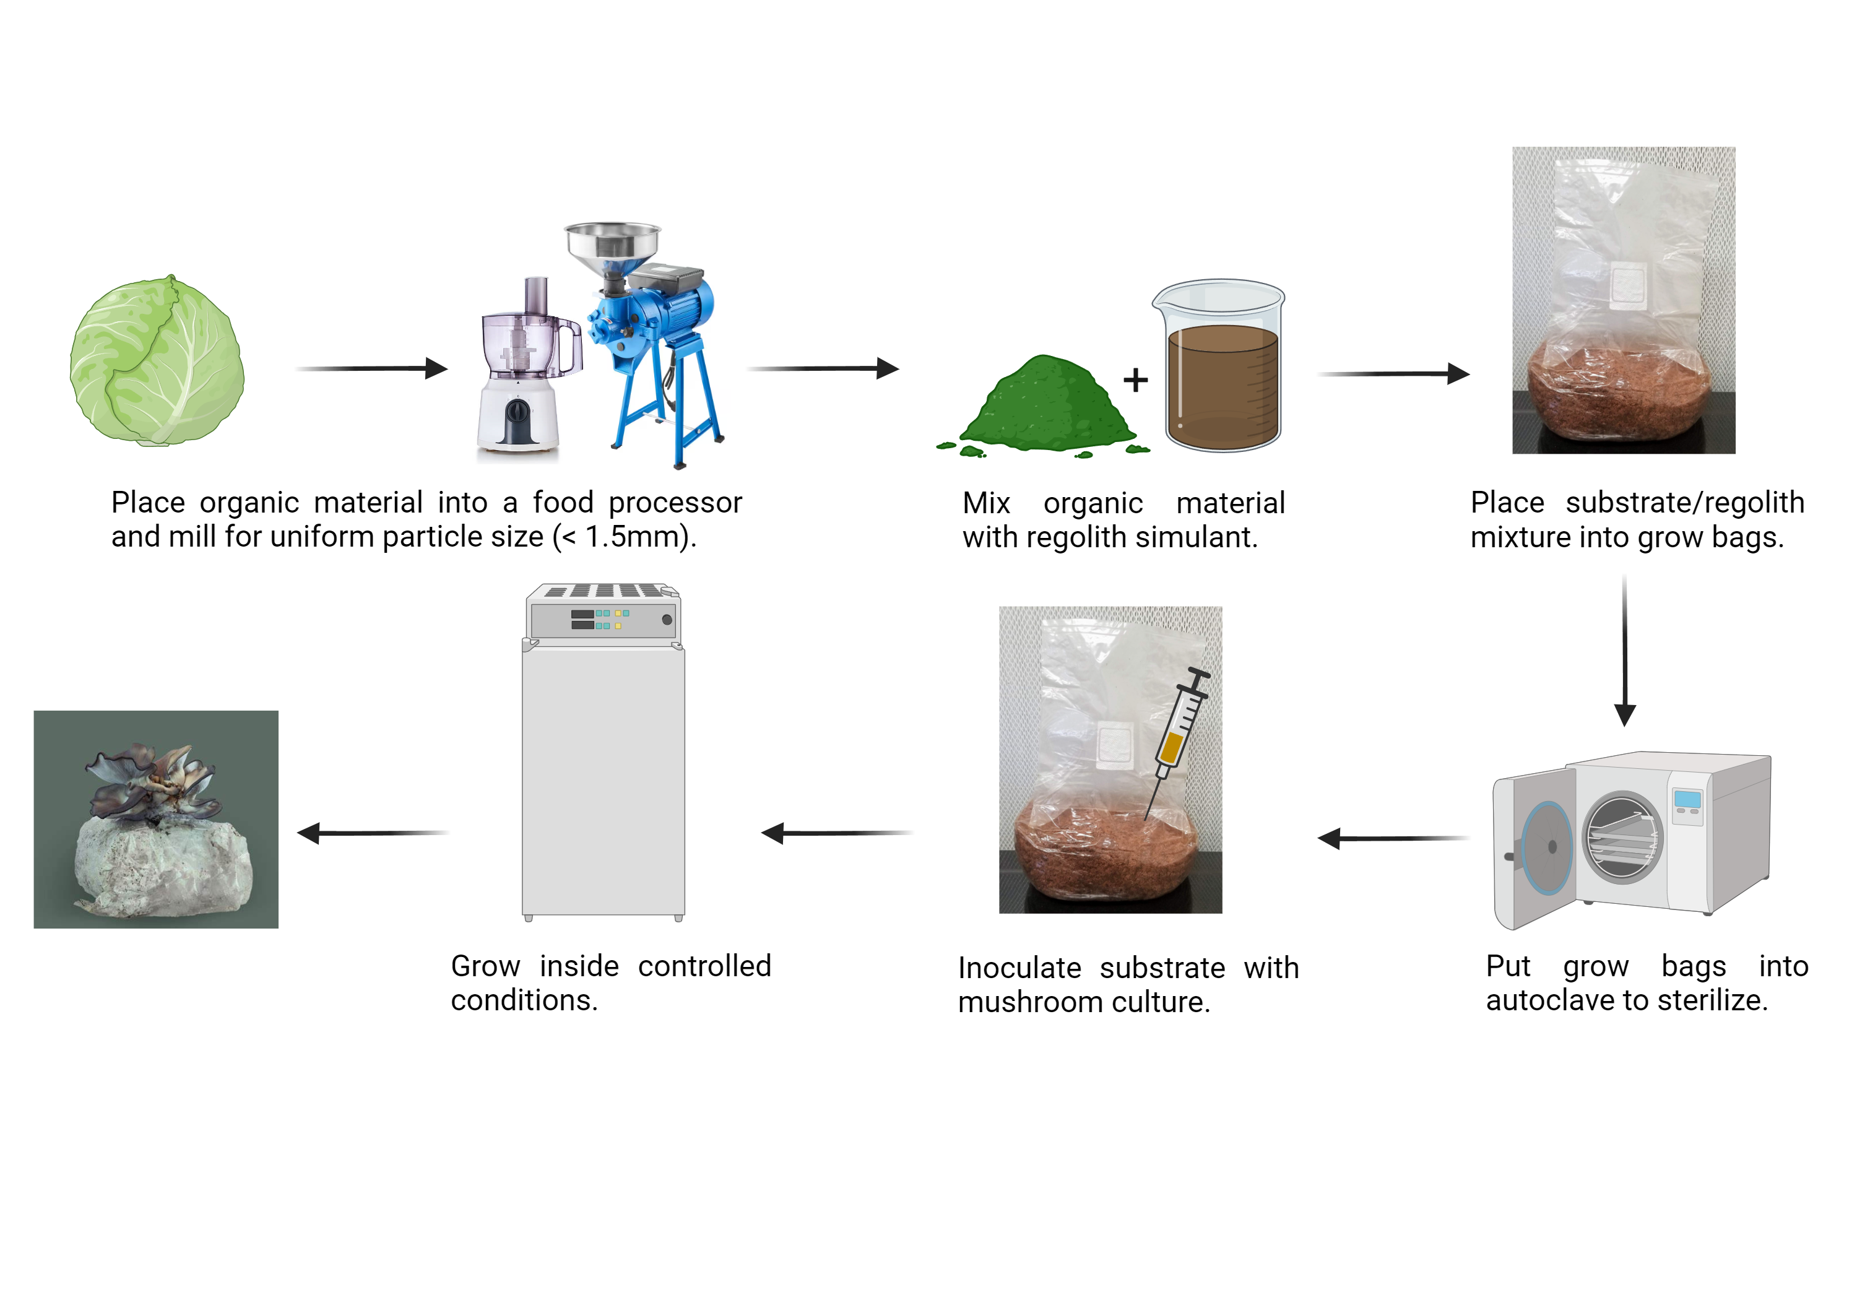
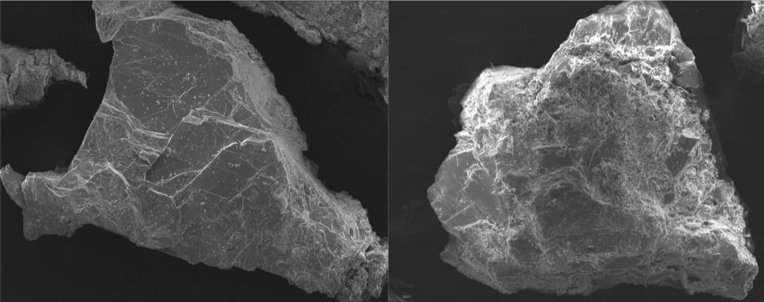
Conversion of Regolith to Soil-Like-Substrate Using Edible Decomposers for Space Settlement and Food Security Application Caitlyn Hubric
Faculty Advisor: Andrew G. Palmer, Departments of OEMS, CCE, Florida Institute of Technology
Background/Objective
Results
Incorporating edible decomposers into bioregenerative life support systems (Figure 1) could facilitate the recycling of plant wastes for a Martian settlement, while generating soil-like-substrates as well as supplemental nutrients.
We hypothesize that a mix of Martian regolith simulant (MRS) and compostable biomass will be a suitable substrate for fungal growth and decomposition.
Here we used Pleurotus ostreatus (Pearl Oyster mushroom) as a model fungi and evaluated:
-The ability of P. ostreatus to decompose organic material (OM) in the presence of Martian regolith.
-Soil characteristics of the substrate before growth.
Figure 3. Substrate Particle Size Composition % by volume before growth.
Figure 4. Substrate pH before growth. n=3.
Figure 1. Current Agriculture Plant Waste Stream (1, Blue). Proposed addition of Edible Decomposers to Plant Waste Recycling System (2, Red). Image made in Biorender.
Figures 5a, 5b. Substrate Wettability Characterization Before Mycelium Colonization. Left 5a: Soil Water Repellency (SWR). Right 5b: Soil Percolation. Demonstrating the time for 1 mL H2O to pass through 2 cm of substrate. n=3.
Figure 6. Images of substrates with and without water droplets to illustrate wettability. Ratios of Organic Material: Regolith indicated for each.
75:25
80:20
85:15
90:10
100:0
95:5
Experimental Design
Figure 8. Images of P. ostreatus mycelium in ratios of OM:Martian Regolith Simulant (MRS). Mycelium colonization of substrate is white.
Figure 7. Timeline of P. ostreatus rate of decomposition across 5 weeks. Orange represents presence of mycelium growth.
Figure 2. Procedure for Preparing Substrate and Growing Mushrooms. Multiple Ratios of Organic Material to Martian Simulated Regolith are tested. Image made in Biorender.
Discussion
-Higher regolith concentration accelerates mycelium colonization.
-Higher regolith concentration improves water repellency but worsens soil percolation prior to colonization.
-P. ostreatus is capable of breaking down low lignin containing material such as cabbage in the presence of Martian Regolith Simulant.
Figure 9. Scanning Electron Microscope Images from Previous Experiment. Left: MRS. Right: MRS After Mycelium Colonization.

