Slide 1
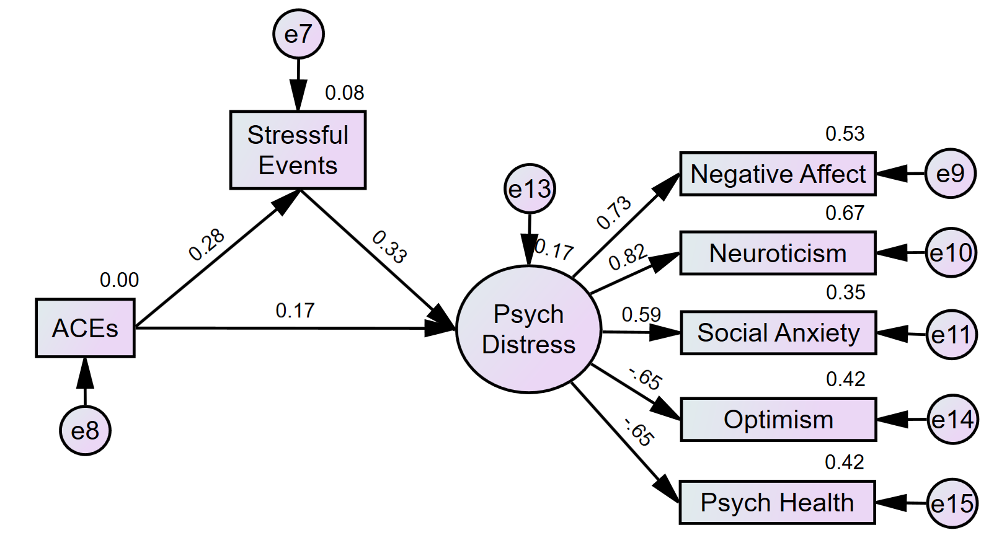
The Relationship Between Mental Health Concerns in College Students
and Adverse Childhood Experiences (ACEs)
Kayla E. Davis
Faculty Advisor: Dr. Travis W. Conradt, School of Psychology, Florida Institute of Technology
Background
Adverse Childhood Experiences (ACEs) increase one’s risk of mental health problems, including depression, anxiety, academic distress, substance use, and suicidality in adulthood (Daníelsdóttir et al., 2024; Watts et al., 2023). These challenges are pertinent during the transitional-college years, a critical developmental period marked by high stress and identity formation. Early-life adversity can negatively impact emotional regulation and coping, placing affected students at greater risk for mental health issues that interfere with academic and social success (Locke et al., 2011). Karatekin (2018) found that college students with more cumulative ACEs reported having more current stressful events. ACEs then predicted mental health problems indirectly (mediation) by increasing current stressors.
Table 1. Study Measures, Descriptives, and Bivariate Correlations
Variable | Measure Description | N | Range | Mean (SD) | 1 | 2 | 3 | 4 | 5 | 6 | 7 | 8
1. ACEs | 16 Yes-No questions; Number of ACEs summed to create score | 766 | 0-13 | 3.38 (3.05) | — | — | — | — | — | — | — | —
2. Income Level | Proxy for SES; 14 ordinal income brackets indicating parents' or personal income bracket | 721 | — | — | −.25** | — | — | — | — | — | — | —
3. Stressful Events | The Undergraduate Stress Questionnaire (Crandall et al., 1992); 82 Yes-No questions; Number of stressful events summed to create score. | 766 | 0-77 | 33.06 (14.50) | .28** | .05 | — | — | — | — | — | —
4. Optimism | Life Orientation Test (Scheier et al., 1994); Sum of 10 items on a 7-point Likert scale | 761 | 6-30 | 19.04 (4.38) | −.15** | .01 | −.19** | — | — | — | — | —
5. Psych Health | Sum of 7 items on a 5-point Likert scale that reflect positive psychological health; Subscale from the LHQ-B (Dinzeo et al., 2014) | 766 | 7-35 | 25.64 (4.86) | −.21** | .02 | −.32** | .45** | — | — | — | —
6. Negative Affect | Sum of 10 items on a 5-point Likert scale; Subscale from the Positive and Negative Affect Schedule (PANAS; Watson et al. 1988) | 766 | 10-49 | 24.30 (7.56) | .18** | −.01 | .28** | −.46** | −.46** | — | — | —
7. Neuroticism | Sum of 10 items on a 5-point Likert scale; Neuroticism subscale from the IPIP 50-Item Set (Goldberg, 1992, Goldberg et al., 2006) | 766 | 10-50 | 31.36 (7.06) | .22** | −.01 | .32** | −.53** | −.52** | .60** | — | —
8. Social Anxiety | Interaction Anxiousness Scale (Leary, 1983; 1990); Sum of 15 items on 5-point Likert scale | 760 | 15-75 | 45.13 (11.66) | .15** | .03 | .17** | −.42** | −.36** | .43** | .49** | —
9. Test Anxiety | Test Anxiety Inventory (Taylor & Deane, 2002); Sum of 10 items on 5-point Likert scale | 765 | 10-50 | 32.29 (10.08) | .16** | −.02 | .23** | −.34** | −.32** | .41** | .45** | .44**
Note. *p < .05; **p < .01
Study Objective and Hypotheses
Objective: Examine childhood adversities (ACEs) and current stressful events as predictors of psychological distress for college students. H1: A higher number of ACEs will be associated with more current stressors as a college student. H2: ACEs and stressful events will both be related to increased psychological distress… ↓ optimism, psychological health ↑ neg. affect, neuroticism, social anxiety, test anxiety H3: Secondary adversities hypothesis: Test whether ACEs increase psychological distress through increased exposure to current stressful life events.
Figure 1. Results of SEM Mediation Analysis
Fit Index | Value | Threshold (Good Fit)
χ² | 1.95 | < 2.00 (Excellent)
p-value | .020 | > .05 (Non-sig preferred)
CFI | .991 | > .95 (excellent)
RMSEA | .035 | ≤ .06
Findings and Conclusions
Both higher numbers of past aversive experiences in childhood and current stressful life events were associated with increased neuroticism, negative affect, social anxiety, and test anxiety, as well as decreased optimism and psychological health. The SEM mediation model found that ACEs and stressful events explained 17% of the overall variability in psychological distress. The number of stressful events partially mediated the effect of ACEs on psychological distress, replicating and extending the previous findings reported by Karatekin (2018) and providing support to the secondary adversities hypothesis. College students with more exposure to childhood adversities continue to experience more stressful life events, which elevate their levels of psychological distress and put them at increased risk for mental health concerns.
Note. Based on theory and the results of a preliminary factor analysis, six measures (variables #4-9 in Table 1 above) were initially identified as collective measures underlying the one construct we called psychological distress. However, SEM showed the best fitting model occurred when test anxiety was excluded as a latent factor of psychological distress.
Method
Participants: 766 Florida Tech students from 2016-2025 (489 female; 63.3% White/Caucasian) with a mean age of 21.01 years (SD = 4.97; range: 18 to 56 yrs). Procedure: The measures included in this study were part of a larger online Qualtrics survey project administered across three questionnaires designed to take students 30 minutes or less.
Table 2. Direct and Indirect Pathways from Structural Equation Models
Direct Paths | β (p-value)
H1: ACEs → Stressful Events | .28** (<.001)
H2A: ACEs → Psychological Distress | .17** (<.001)
H2B: Stressful Events → Psychological Distress | .34** (<.001)
Indirect Paths | β (p-value)
H3: ACEs → Stressful Events → Psych Distress | .09** (<.001)
Notes:
Research shows that 50–70% of college students report at least one ACE, with up to 20% reporting four or more (Underwood et al., 2024).
While university counseling centers commonly use standardized mental health assessments, it is unclear if these tools effectively capture trauma-related concerns tied to ACE exposure.
This study evaluates whether subscales modeled after the CCAPS-62 appropriately reflect ACE-related mental health symptoms in college students. By analyzing retrospective data from Florida Tech students, the goal is to assess whether current tools meet student needs and to support the advancement of trauma-informed mental health practices on campus.

