Slide 1
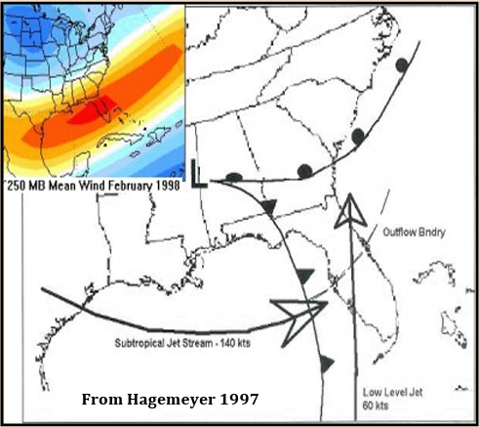
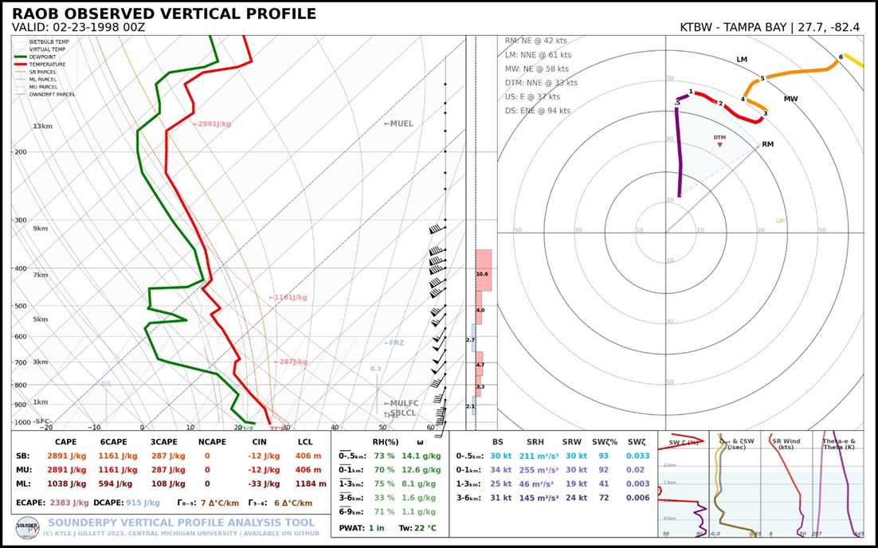
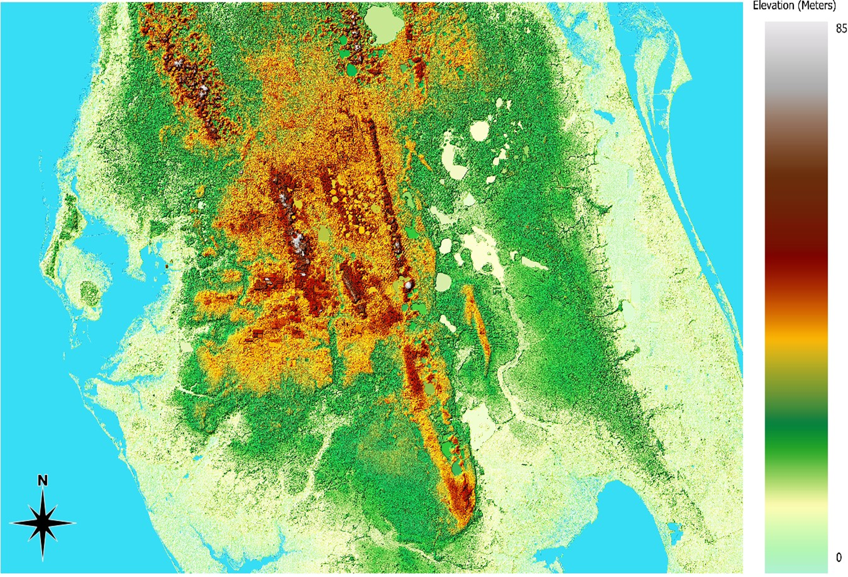
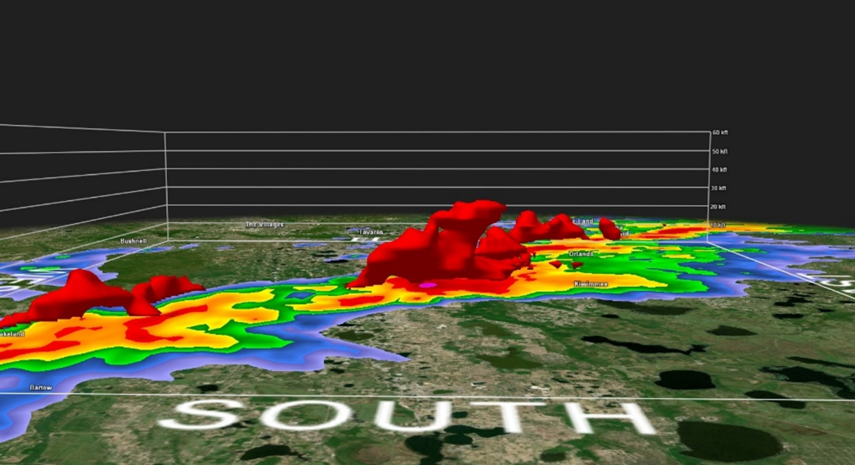
The 1998 Central Florida Tornado Outbreak:
A Comprehensive Case Study in Tampa, FL
Brandan Keen
Faculty Advisor(s): Dr. Milla Costa, Melissa Zavaleta, Dept. of Ocean Engineering and Marine Sciences
Florida Institute of Technology
Abstract: The 1998 Central Florida Tornado Outbreak was Florida’s most destructive tornado event, spawning three significant F3 tornadoes during the overnight hours of February 22–23. This study investigates the mesoscale and storm-scale processes associated with the outbreak, specifically analyzing the supercell responsible for the Kissimmee tornado. The analysis utilizes NEXRAD WSR-88D Level 2 radar data (KMLB, KTBW) processed in Gibson Ridge Analyst software, atmospheric soundings from the Storm Prediction Center, and topographic relief maps generated in QGIS. Results highlight moderate atmospheric instability, significant vertical wind shear, and potential interactions between severe convection and local terrain Findings emphasize the potential role of the Lake Wales Ridge in modulating storm intensity and supporting tornadogenesis, indicating a potential avenue for future research into topographic influences on severe convective activity in the region.
Introduction:
• Central Florida (27.5°–29.0°N, 81.0°–82.5°W) experiences high tornado frequency. From 1950–2008, 89% were F0–F1 and 11% F2+ (Hagemeyer, 1997). • Of 28 F3+ tornadoes, 21 occurred during the dry season (Nov–Apr). • Peak tornado activity: June–Aug, 2–5 PM; outbreaks often occur in the morning. • El Niño shifts and amplifies the subtropical jet, raising violent tornado risk. • Tornadic setups feature strong wind shear and weak to moderate instability. • Low-level moisture advection is the main driver of instability. • Topography enhances tornadogenesis via upslope flow, vorticity stretching, and convergence (Schneider, 2009). • Elevation changes as small as 20 meters can influence tornado development and intensity (Lyza & Knupp, 2014).
Figure 1: Ideal synoptic set-up capable of producing and sustaining tornadic supercells. (Hagemeyer 1997)
Figure 2: KTBW Preoutbreak Sounding and Hodograph on February 23rd, 1998 at 00Z.
Data and Methods:
• NEXRAD WSR-88D radar (Level 2) from KMLB and KTPA analyzed using Gibson Ridge Analyst software (base reflectivity, velocity, storm-relative velocity, spectrum width, volumetric scans). • Atmospheric sounding data sourced from Storm Prediction Center and plotted via SounderPy. • Topographical maps created in QGIS using NASA Earthdata.
Figure 3: Topographical Relief Map of Central Florida.
Figure 4: 50 dBZ Isosurface volumetric scan at 0530 UTC showing enhanced supercell updraft over Lake Wales Ridge 10 minutes prior to the Kissimmee tornado.
Results/Conclusions/Future Considerations:
The 00Z Feb 23 KTBW sounding (Fig. 2) indicated moderate surface-based instability (SBCAPE = 2891 J/kg), a pronounced mid-level dry layer, and steep lapse rates, supporting enhanced downdraft potential as reflected in a DCAPE of 915 J/kg. The hodograph exhibited a sharp unidirectional wind speed increase within the lowest 0.5 km, followed by pronounced veering—features indicative of a highly sheared profile favorable for tornadogenesis..Volumetric WSR-88D radar data (Fig. 4), sampled at 0530 UTC, showed a deep, organized reflectivity core over the Lake Wales Ridge. In conjunction with the topographic relief (Fig. 3), this suggests a terrain-induced enhancement of the storm's updraft 10 minutes prior to the Kissimmee tornado’s touchdown at 0540 UTC. These results suggest the need for further research into boundary layer–terrain interactions and the thermodynamic influences of the Lake Wales Ridge on tornadic supercell evolution in Central Florida.

